Slide 1

Making Sense of High-Throughput Sequencing (short read) Data
28-29 October 2019
Chris Barratt - Flexpool postdoc at iDiv in Evolution and Adaptation (PI: Renske Onstein) and Sustainability and Complexity in Ape Habitat (PI: Hjalmar Kuehl)

Slide 2
What are we doing today?
We already did a workshop in May based on the background, sampling design and bioinformatic processing of RAD-seq data with a HPC cluster (little refresher first)
Your learning outcomes from this course are how to run and interpret 6 independent downstream analyses to make sense of high throughput short-read data:
Population structure (Admixture, DAPC)
Evolutionary relationships (RAxML, SNAPP)
Landscape barriers and population connectivity (EEMS)
Historical demographic inference and hypothesis testing (∂a∂i)

Slide 3
Why these programs?
The programs we will use are amongst the most common representatives for kinds of analyses which can be performed with many other pieces of published code
These are not exactly user friendly, but they are tried and tested, and are the emergent types of analyses which have stuck around after the NGS methods explosion of the last 10 years or so
Perhaps most importantly they are well documented and still maintained for when you run into a problem
These analyses are very up to date as of 2019, but things change quickly and new methods are always coming

Slide 4
First things first…
We need to access the UFZ cluster (terminal or puTTy)
We need a good FTP client (I recommend CyberDuck but FileZilla also fine) and notepad style editor (TextWrangler/Bbedit for Mac or notepad++ for windows)
Install Rstudio, BEAST, PGDspider on your laptop/mac
We need to build our own python and bioconda environments on the cluster for running some of the analyses (ca. 2 mins using the create_environments.sh script)
We need to make sure our directory structure is fine. Easiest I suggest is to do scp -r /public/barratt/ /public/$USER/
> Then any submit script you simply need to change ‘barratt’ for your account name

Slide 5
Directory structure on cluster (in /public/$USER/)
submit_scripts (all scripts to process the data)
work (working folder)
virtual_env_RADseq (virtual environment we created)
If you run this command from your terminal it will download all the files for completed analyses:
rsync --dry-run -avhP -e 'ssh -p 8022' -r barratt@localhost:/public/barratt/ /Users/chris/Desktop/Workshop_2/

Slide 6
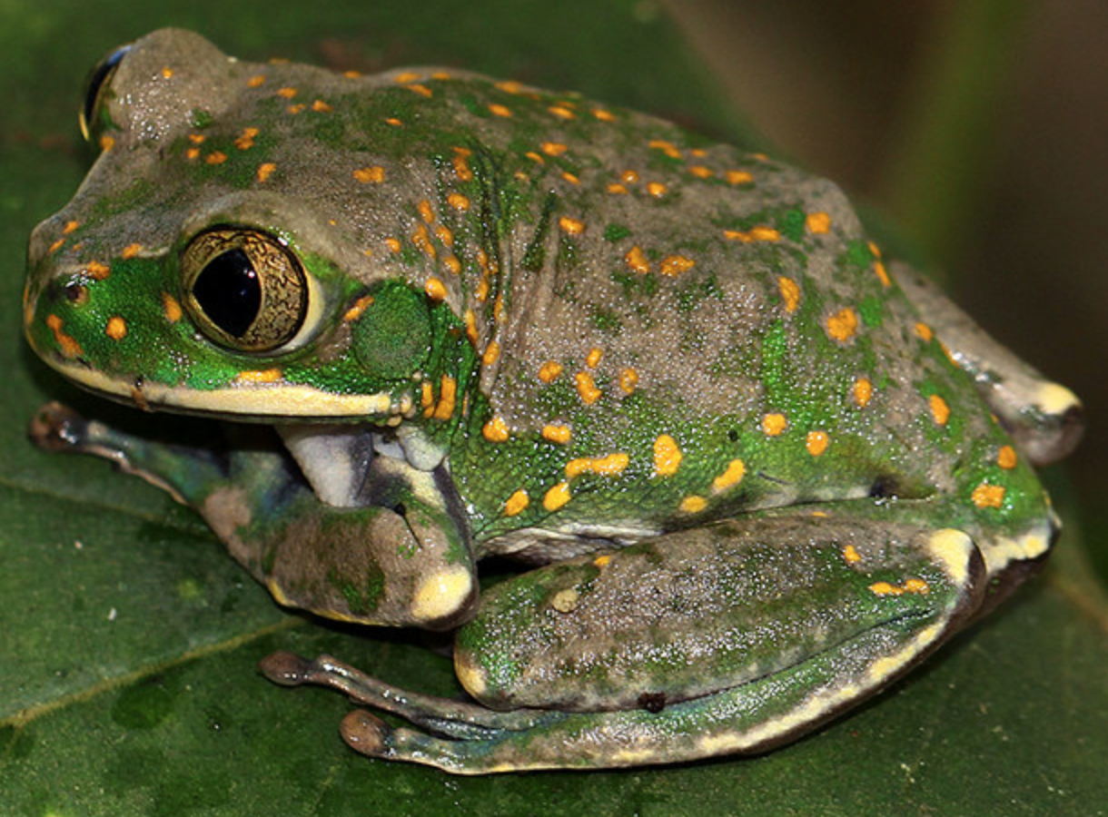
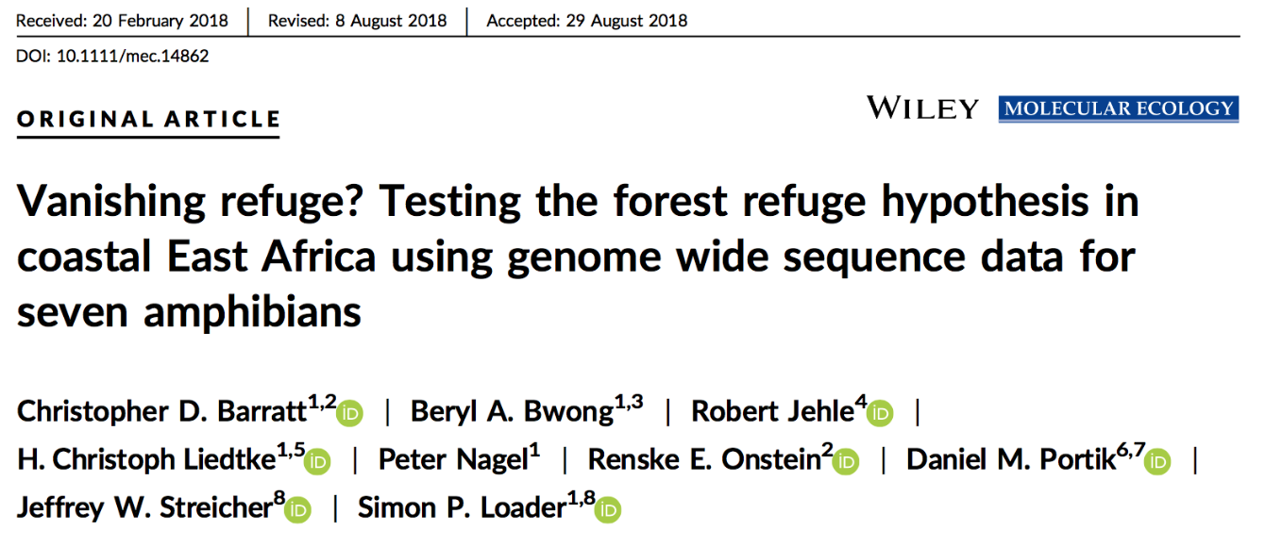

Example data we are working with
Leptopelis flavomaculatus – Yellow spotted treefrog (n=59) – originally from 42.3 GB of data
Processed output files are just a few hundred MB

Slide 7
Input files we need to do the analyses
Because processing RAD-seq data is so processor and time intensive I pre-prepared the data so it is ready to analyse – it has already been analysed by Stacks so we are working with the output files from there
These datasets use only single SNPs from each RAD locus which is present in at least 50% of all samples (most samples have only a little missing data), >5x coverage and with a minor allele frequency >0.05, which gives 8598 SNPs

Slide 8
Population structure
= the patterns in neutral variation that result in departure from panmixia
Understanding population structure tells us something about past and present changes in migration regimes
This information is a basis for understanding which evolutionary or environmental factors are acting upon species
Essential for understanding how evolution operates at smaller scales

Slide 9
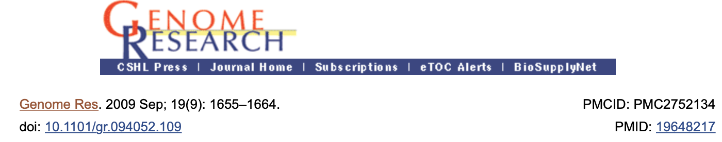
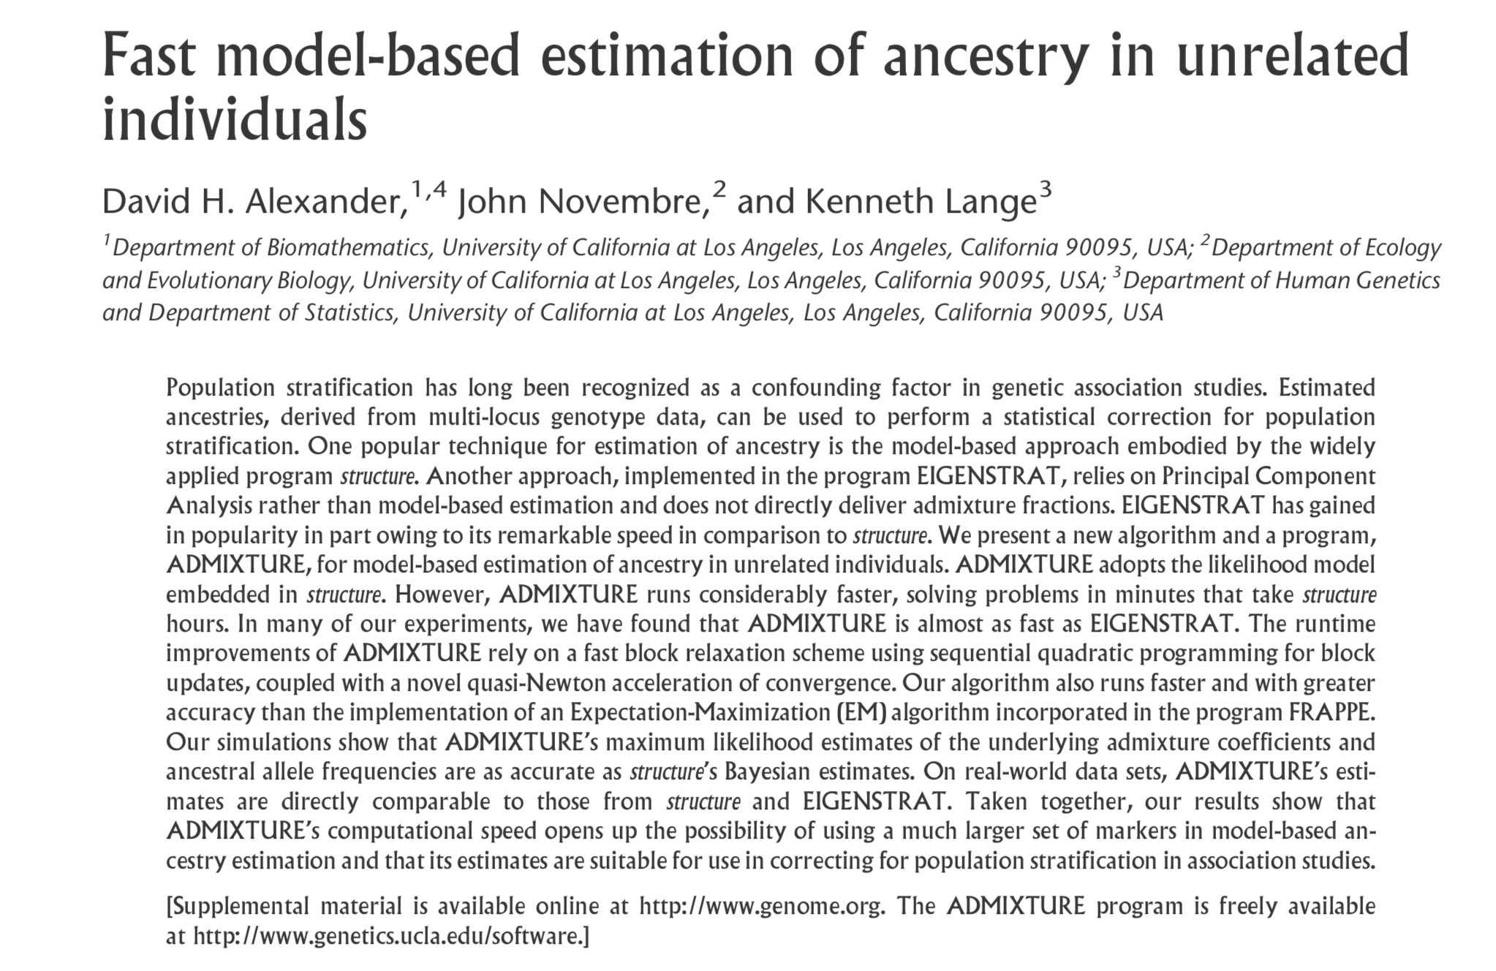
Population structure - Admixture
A good tool for looking at population structure in genomic data is with Admixture (Alexander et al. 2009)

Slide 10
Population structure - Admixture
ML estimation of individual ancestries from SNP datasets
Uses same statistical model as Structure (Pritchard, Stephens & Donnelly, 2000) – the benchmark for understanding pop structure the past 20 years
Uses a block relaxation approach for speed, which outperforms the other methods – they simply become inefficient and intractable for large SNP data

Slide 11
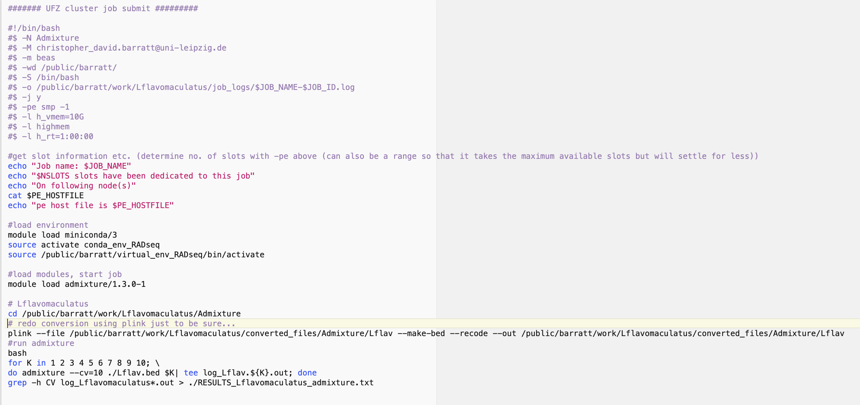
Population structure - Admixture
Using the run_Admixture.sh script we run the algorithm for a range of k values on the dataset
Admixture needs a .bed file (converted by plink), and uses cross validation scores to give you the most likely number of clusters for your data

Slide 12
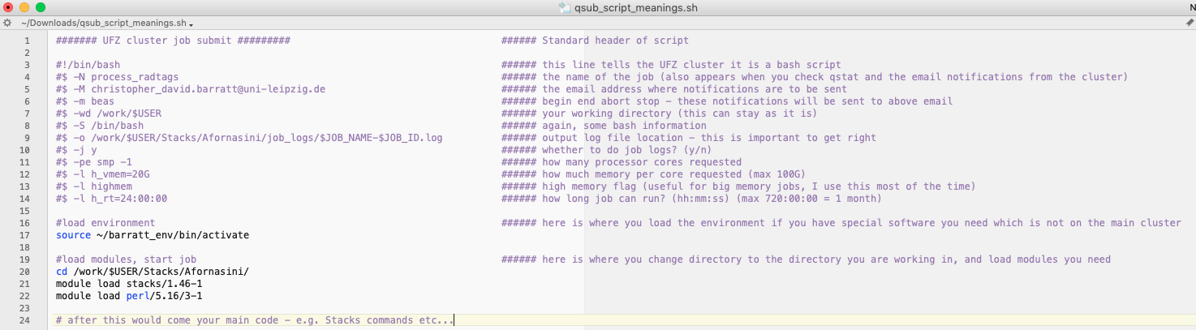
qsub shell script in more detail
Some header information is needed to tell the cluster how to process your jobs, how much resources to use, where to send notifications etc.
See https://wiki.ufz.de/eve/index.php/Submitting_Jobs for much more detailed information

Slide 13
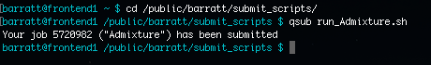
Population structure - Admixture
We submit this on the cluster – so cd to your submit scripts directory and type qsub run_Admixture.sh followed by enter. This is a relatively small dataset so will only take a couple of mins to run
When it has finished you will receive an email notification (if you edited your scripts to change the email notifications)

Slide 14
Population structure - Admixture
The job log file (in /public/$USER/work/Lflavomaculatus/job_logs) contains the output from the Admixture run, have a look at it
Within the script we already used grep on the last line to grab the CV values for each iteration of k and send them to an output file. So in /public/$USER/work/Lflavomaculatus/Admixture/ there is a RESULTS_Lflavomaculatus_admixture.txt file
Let’s visualise that in R using the 1_PLOT_ADMIXTURE.R script. To get the file on your computer you can either drag and drop from your FTP client (Cyberduck or FileZilla) or use rsync:
rsync --dry-run -avhP -e 'ssh -p 8022' -r barratt@localhost:/public/barratt/ /Users/chris/Desktop/Workshop_2/

Slide 15
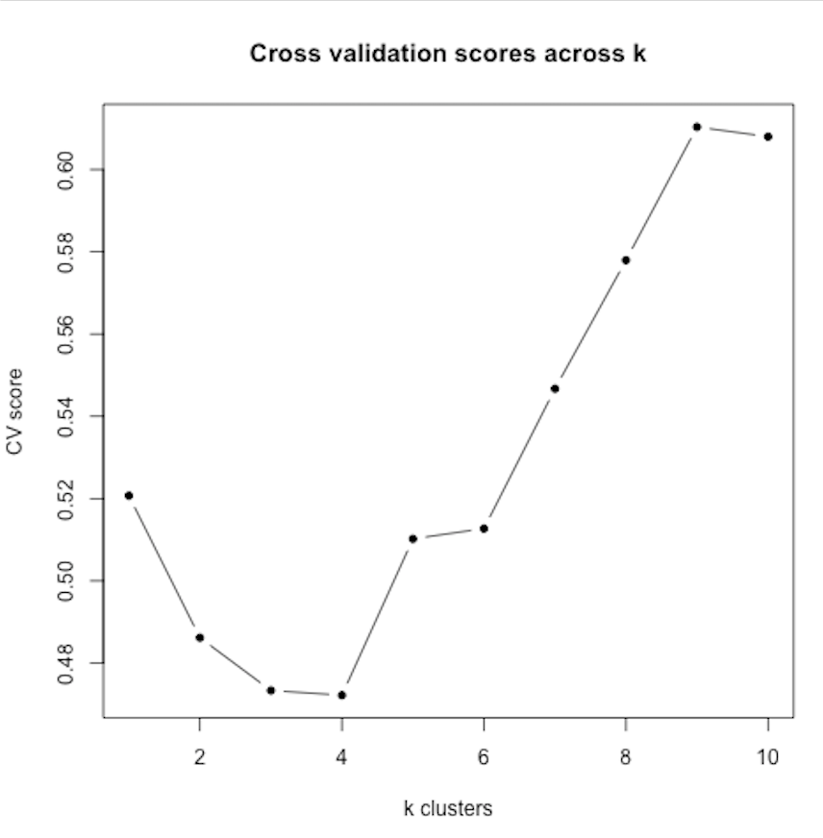
Population structure - Admixture

Slide 16
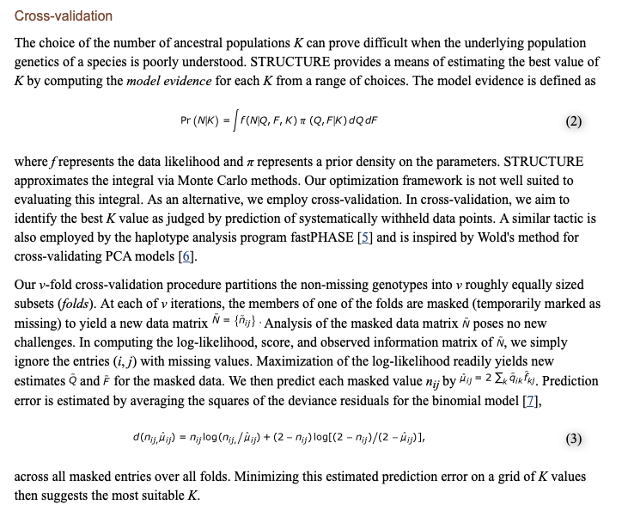
Population structure - Admixture

Slide 17
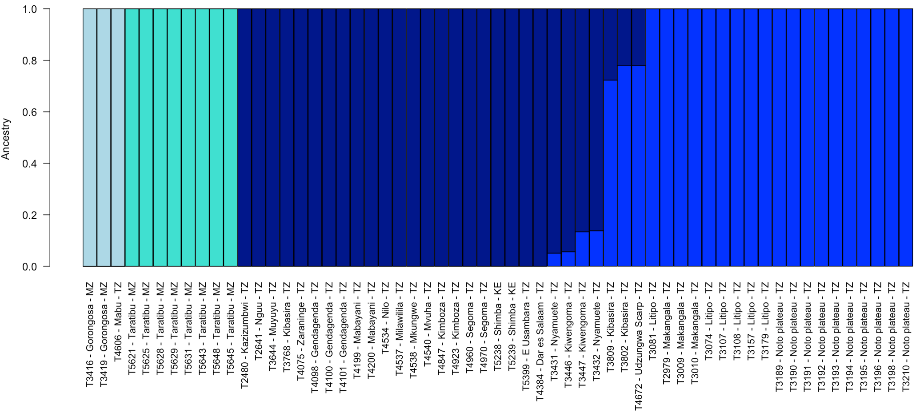
Population structure - Admixture
So k=4 seems to be a fairly good description of the structure for this data, population structure is fairly straightforward to interpret in this case
Note that we do have some admixture between some pops!

Slide 18
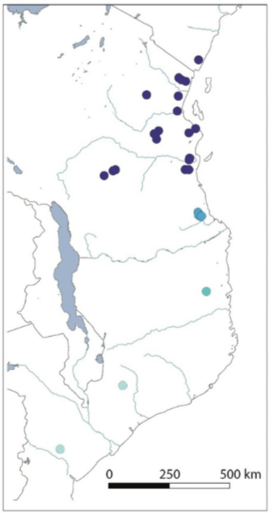
Population structure - DAPC

Slide 19
Population structure - DAPC
What is DAPC? Discriminant function Analysis of Principal Components (Jombart et al. 2010) – a multivariate method
Admixture is great, but it can run into problems if your loci are not in Hardy-Weinberg equilibrium, which may not be the case especially if you have small population sizes. Best to try a few other methods which can give your more confidence in your population structure analyses…
DAPC is one such method free from HWE assumptions, and the algorithm works slightly differently so it is independent from Admixture. A good tutorial can be found here (we will do an exercise modified from this)

Slide 20
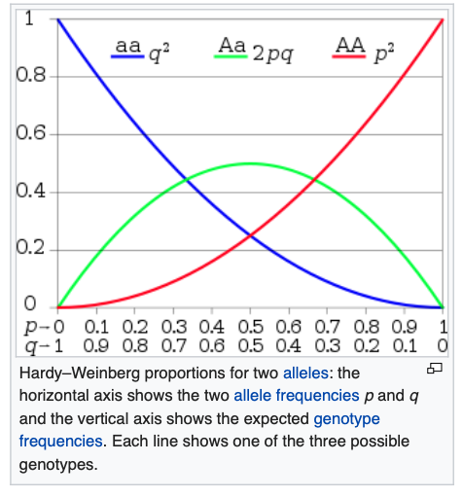
Population structure - DAPC
Hardy-Weinberg principle:
Allele and genotype frequencies will remain constant from generation to generation without external evolutionary influences
Selection
Mutation
Gene flow (migration)
Genetic drift random changes (e.g. small population sizes)

Slide 21
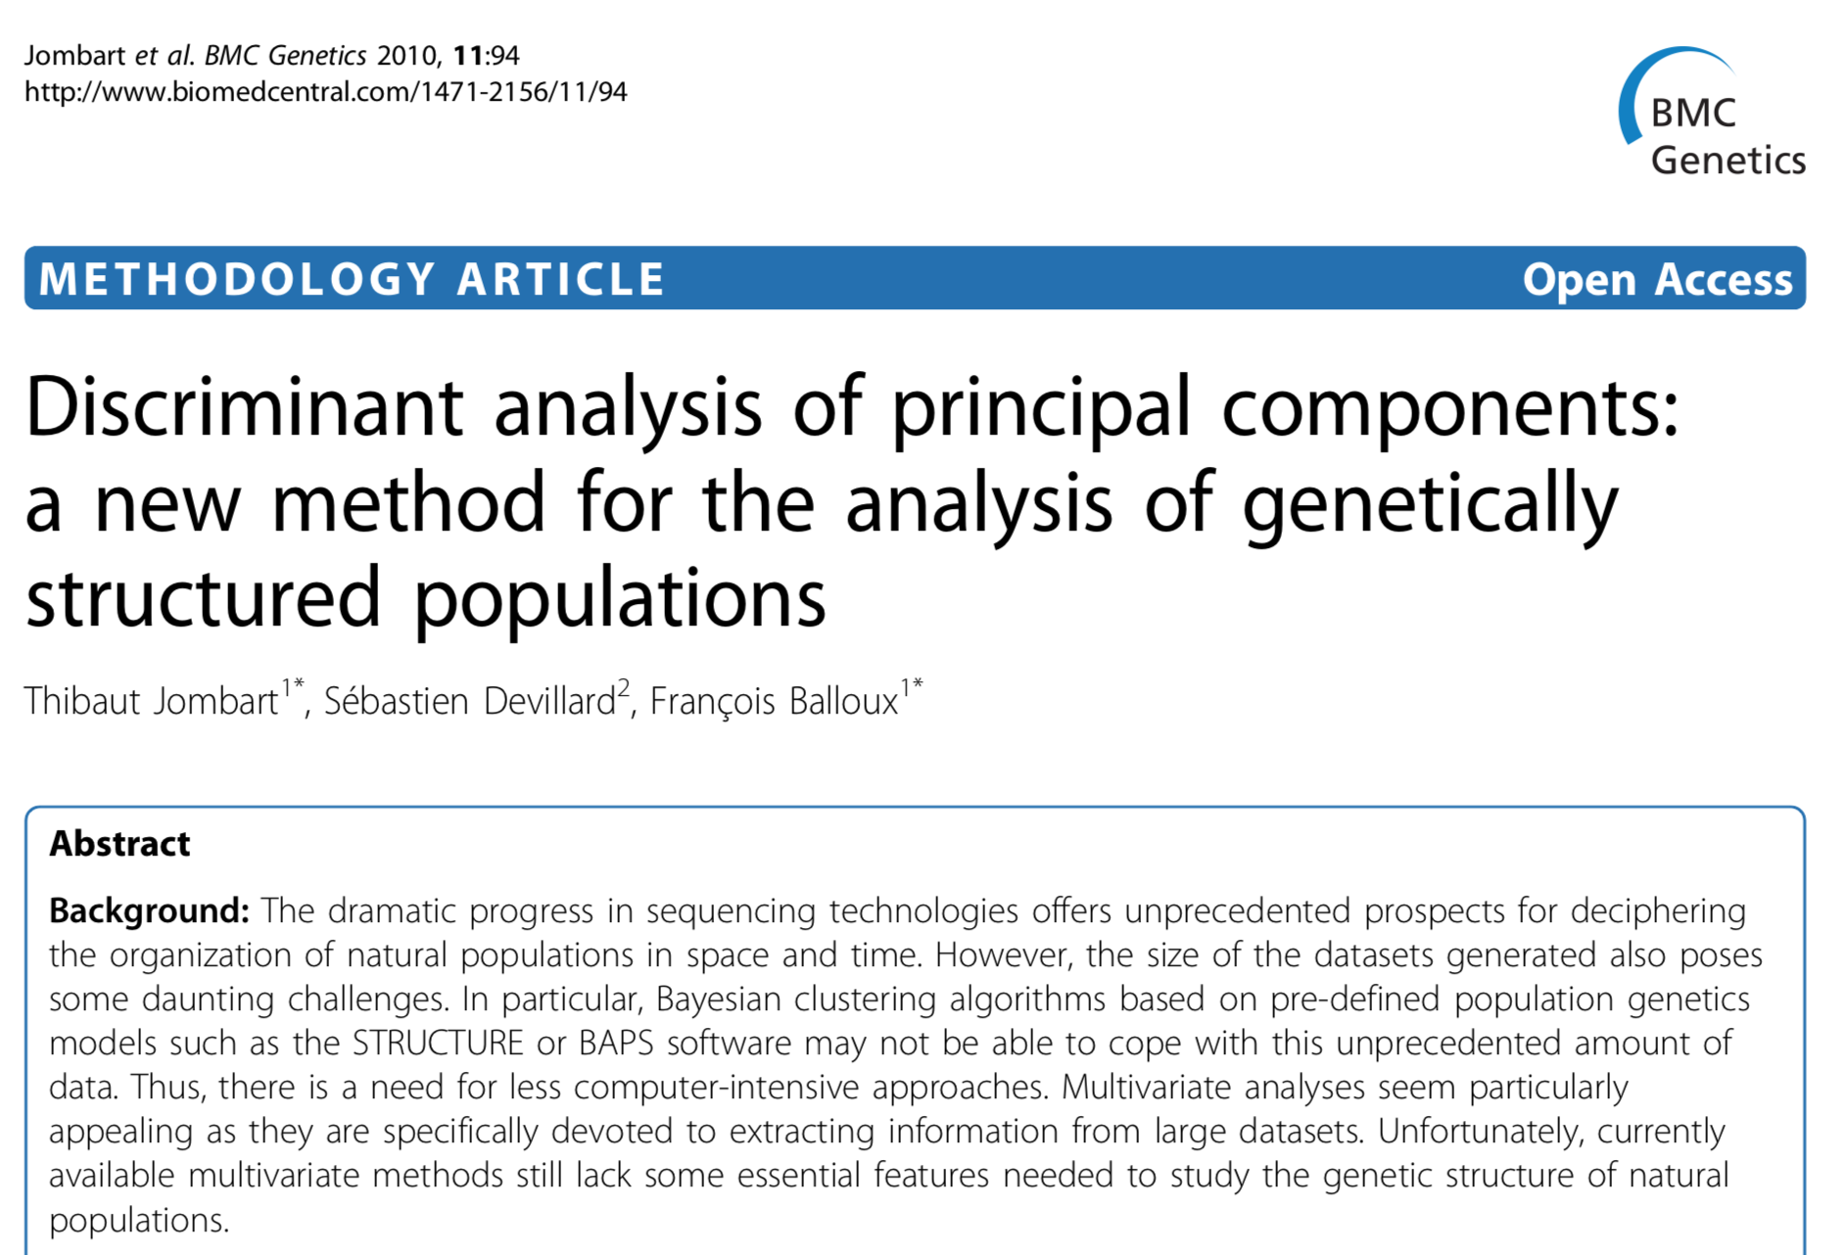
Population structure - DAPC

Slide 22
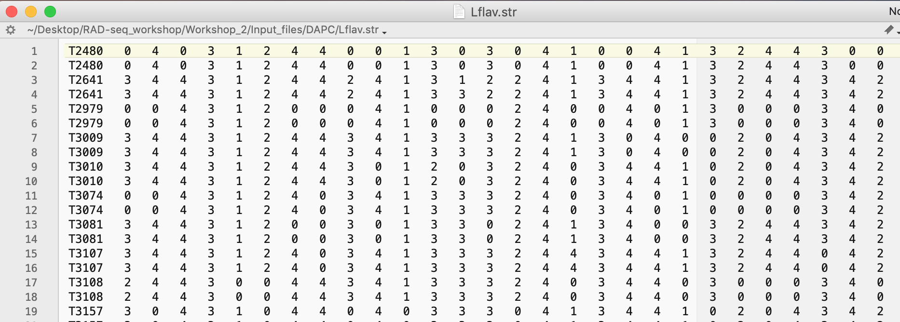
Population structure - DAPC
For DAPC population stucture analyses the .str file output from Stacks contains all the info we need. However we can delete the first 2 lines output by Stacks (they are not necessary and other programs don’t like it)

Slide 23
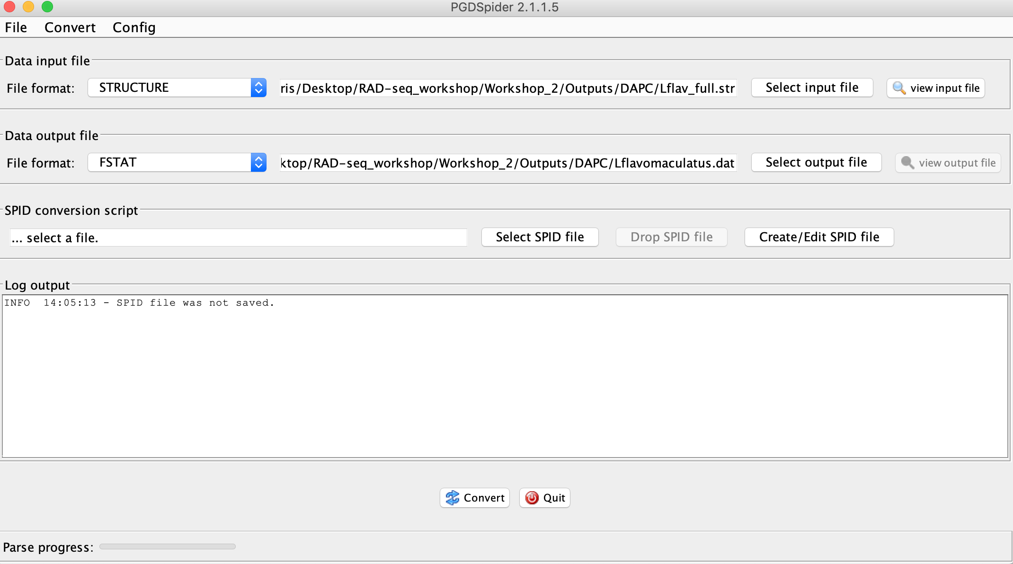
Population structure - DAPC
We can use PGDspider2.jar to convert the files we need (from STRUCTURE to FSTAT for DAPC)

Slide 24
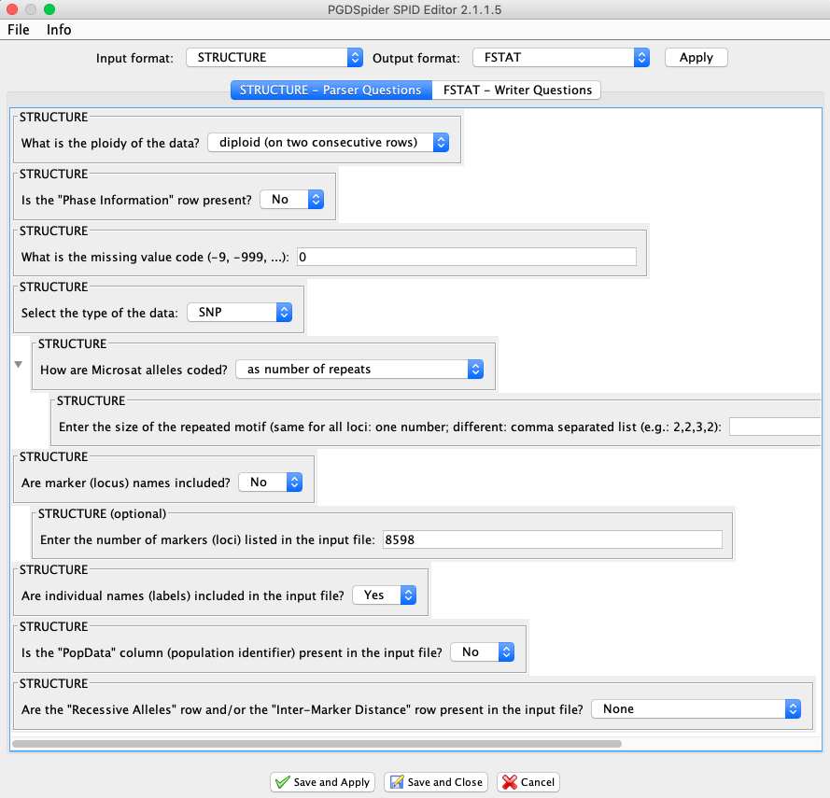
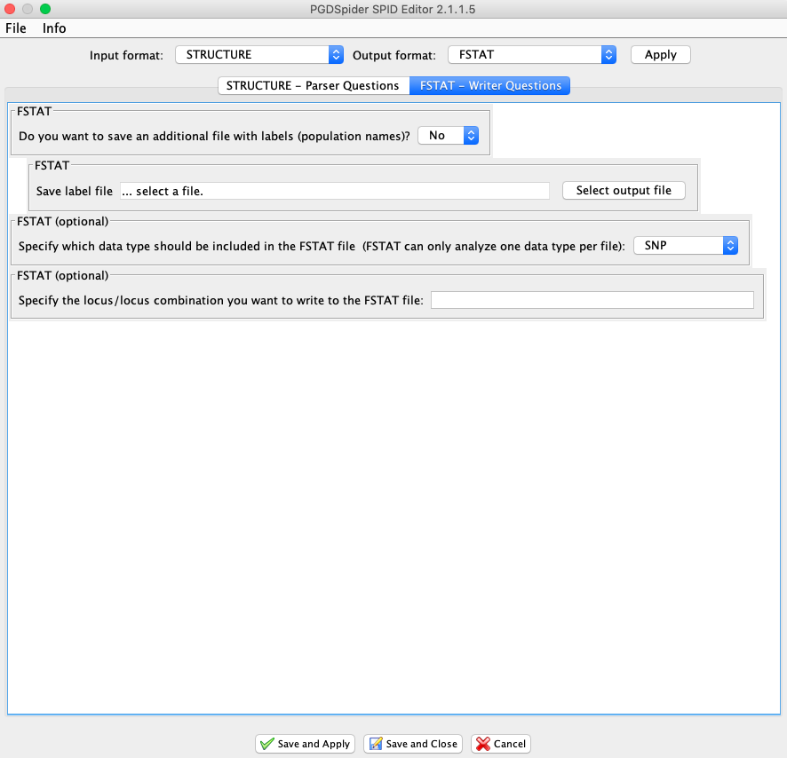
Population structure - DAPC
We can use PGDspider2.jar to convert the files we need (from STRUCTURE to FSTAT for DAPC)

Slide 25
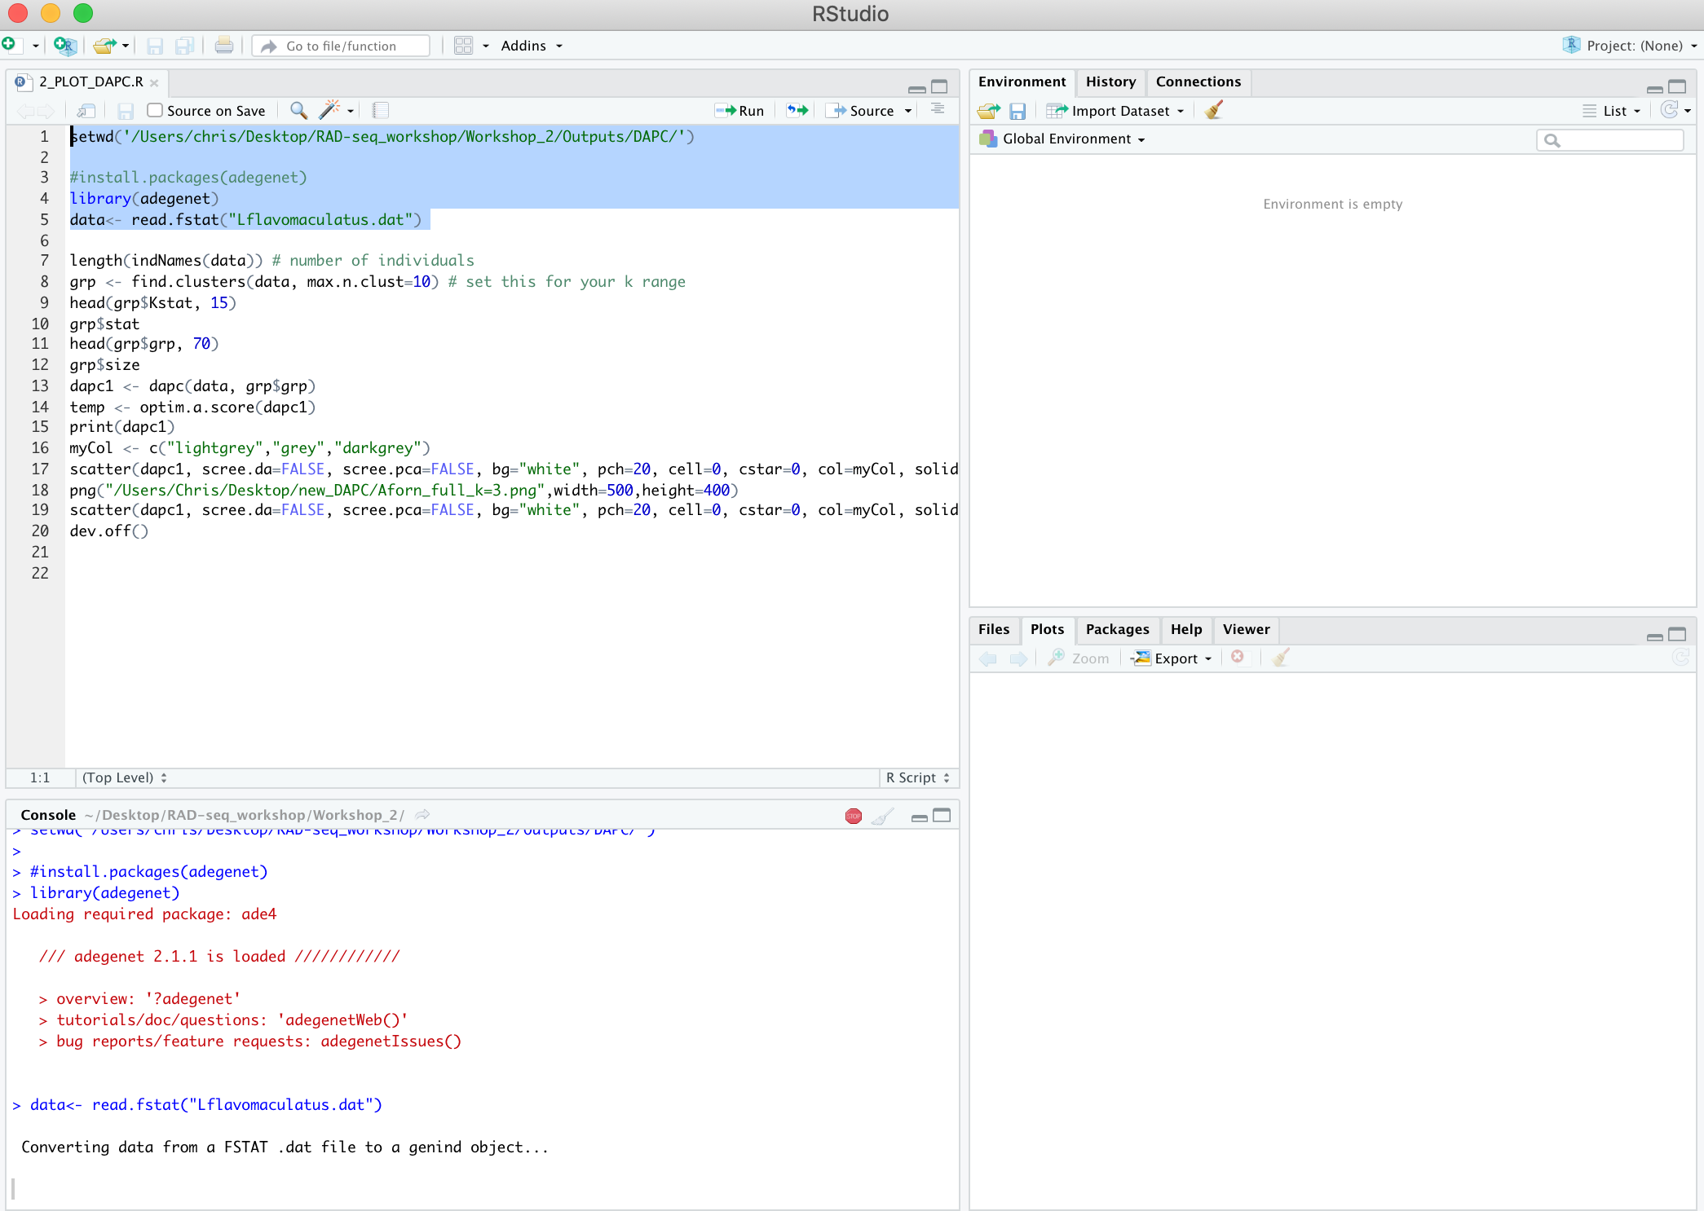
Population structure - DAPC
Now with the resulting .dat file we can run DAPC with the script 2_RUN_AND_PLOT_DAPC.R - Run the first 5 lines (this will take a few mins)

Slide 26
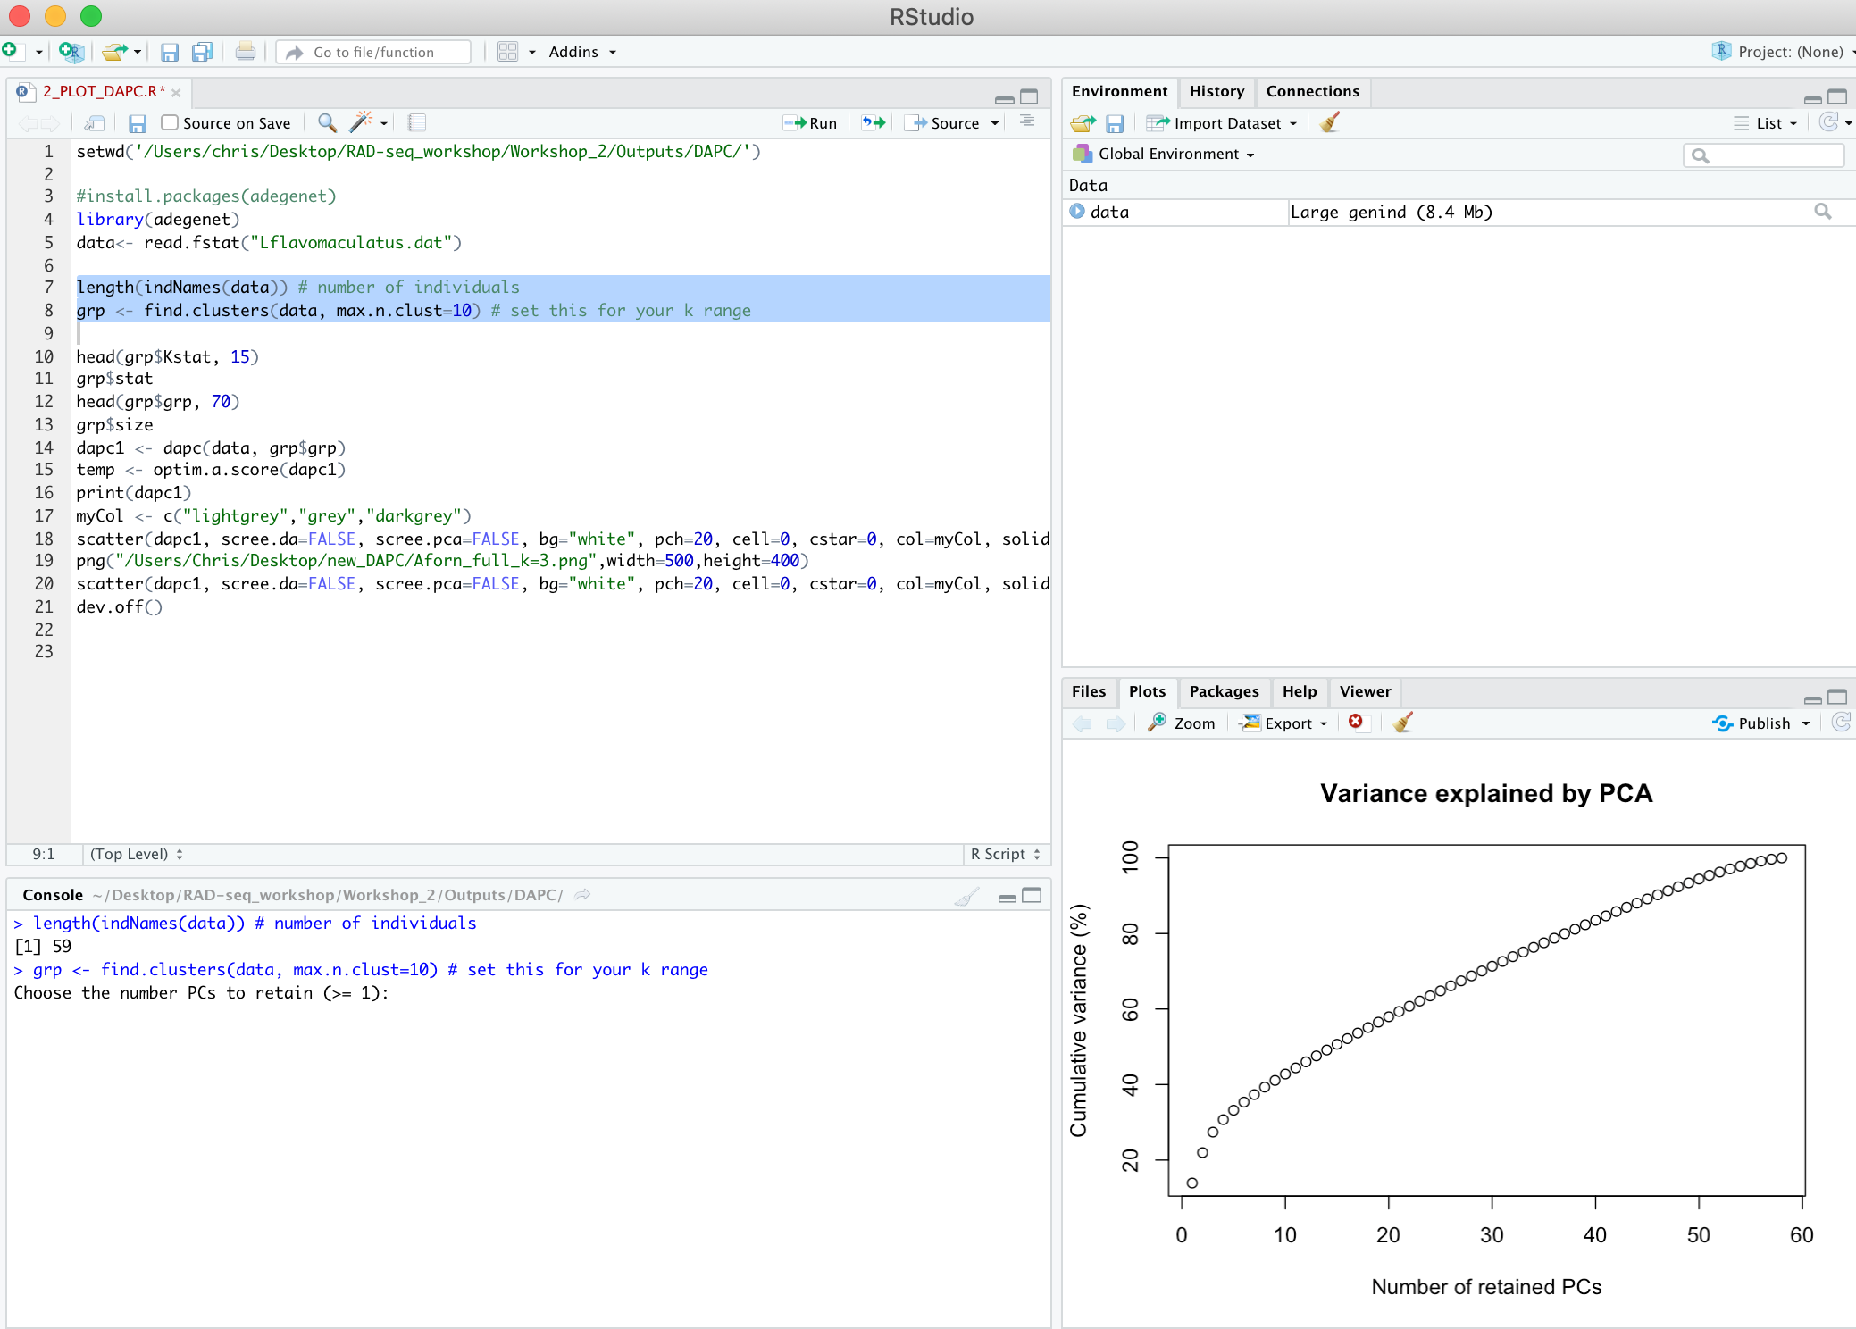
Population structure - DAPC
Enter the value where line starts to level out (in this case at the end)

Slide 27
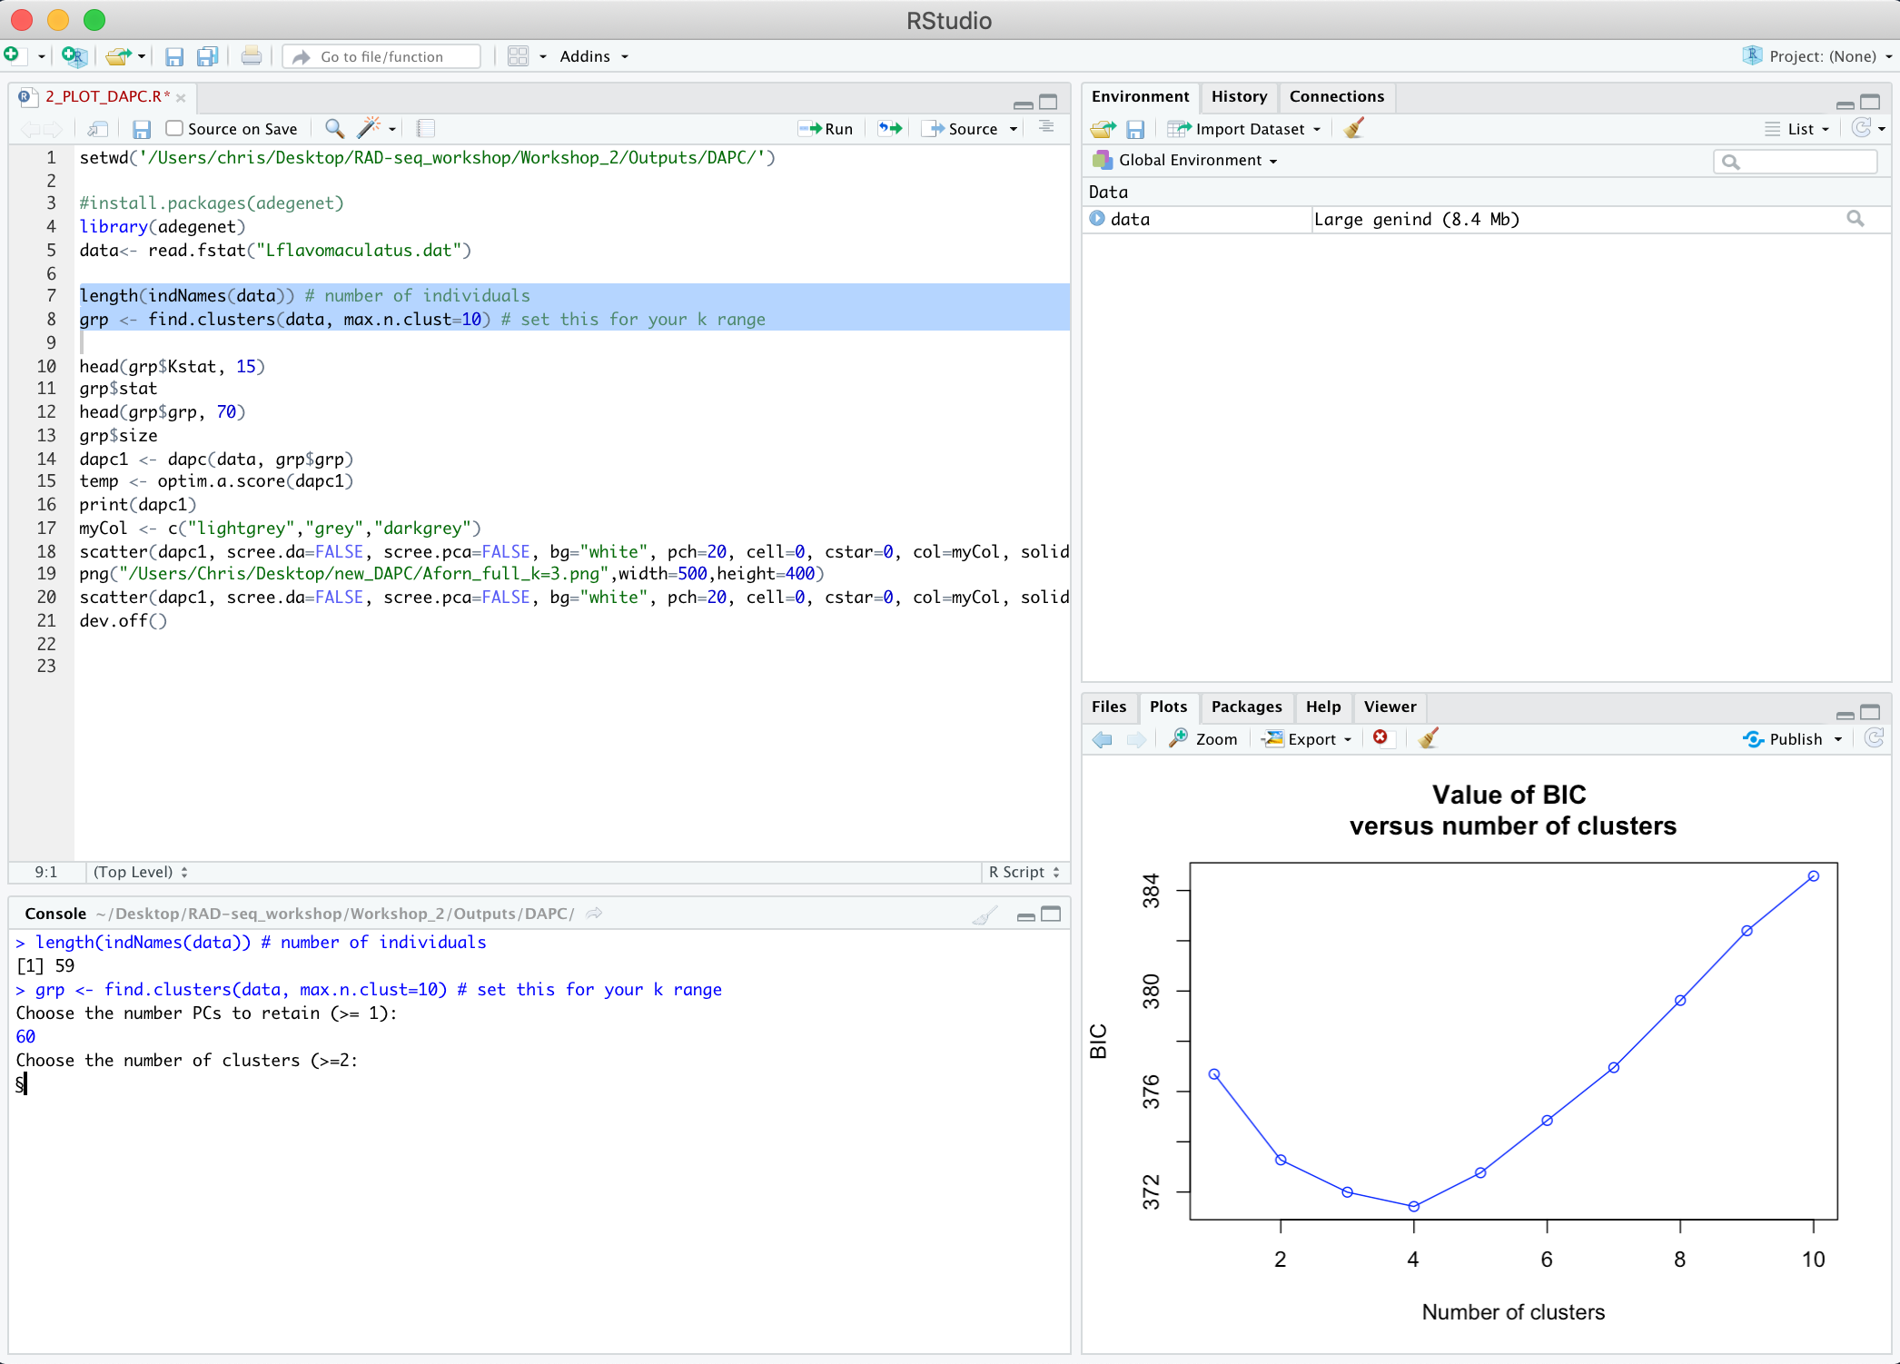
Population structure - DAPC
Enter how many clusters are present based on the lowest BIC score (Bayesian Information Criterion)

Slide 28
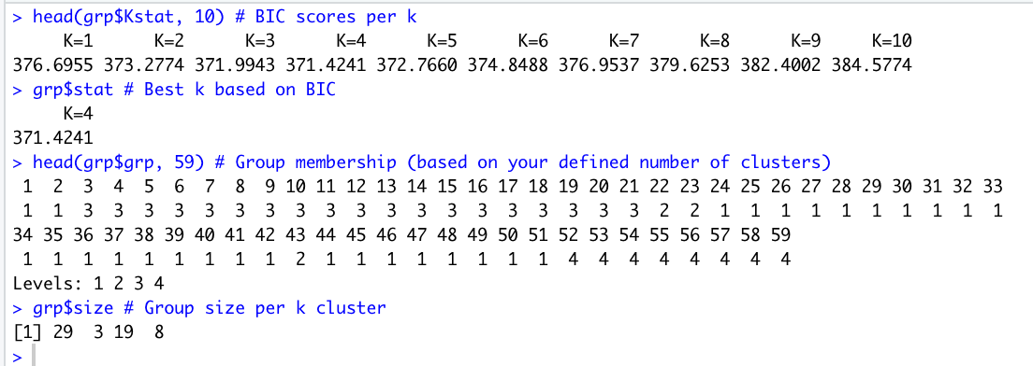
Population structure - DAPC
Lines 10-13 will give you some info about the data including accurate BIC scores, best k chosen, cluster membership and cluster sizes

Slide 29
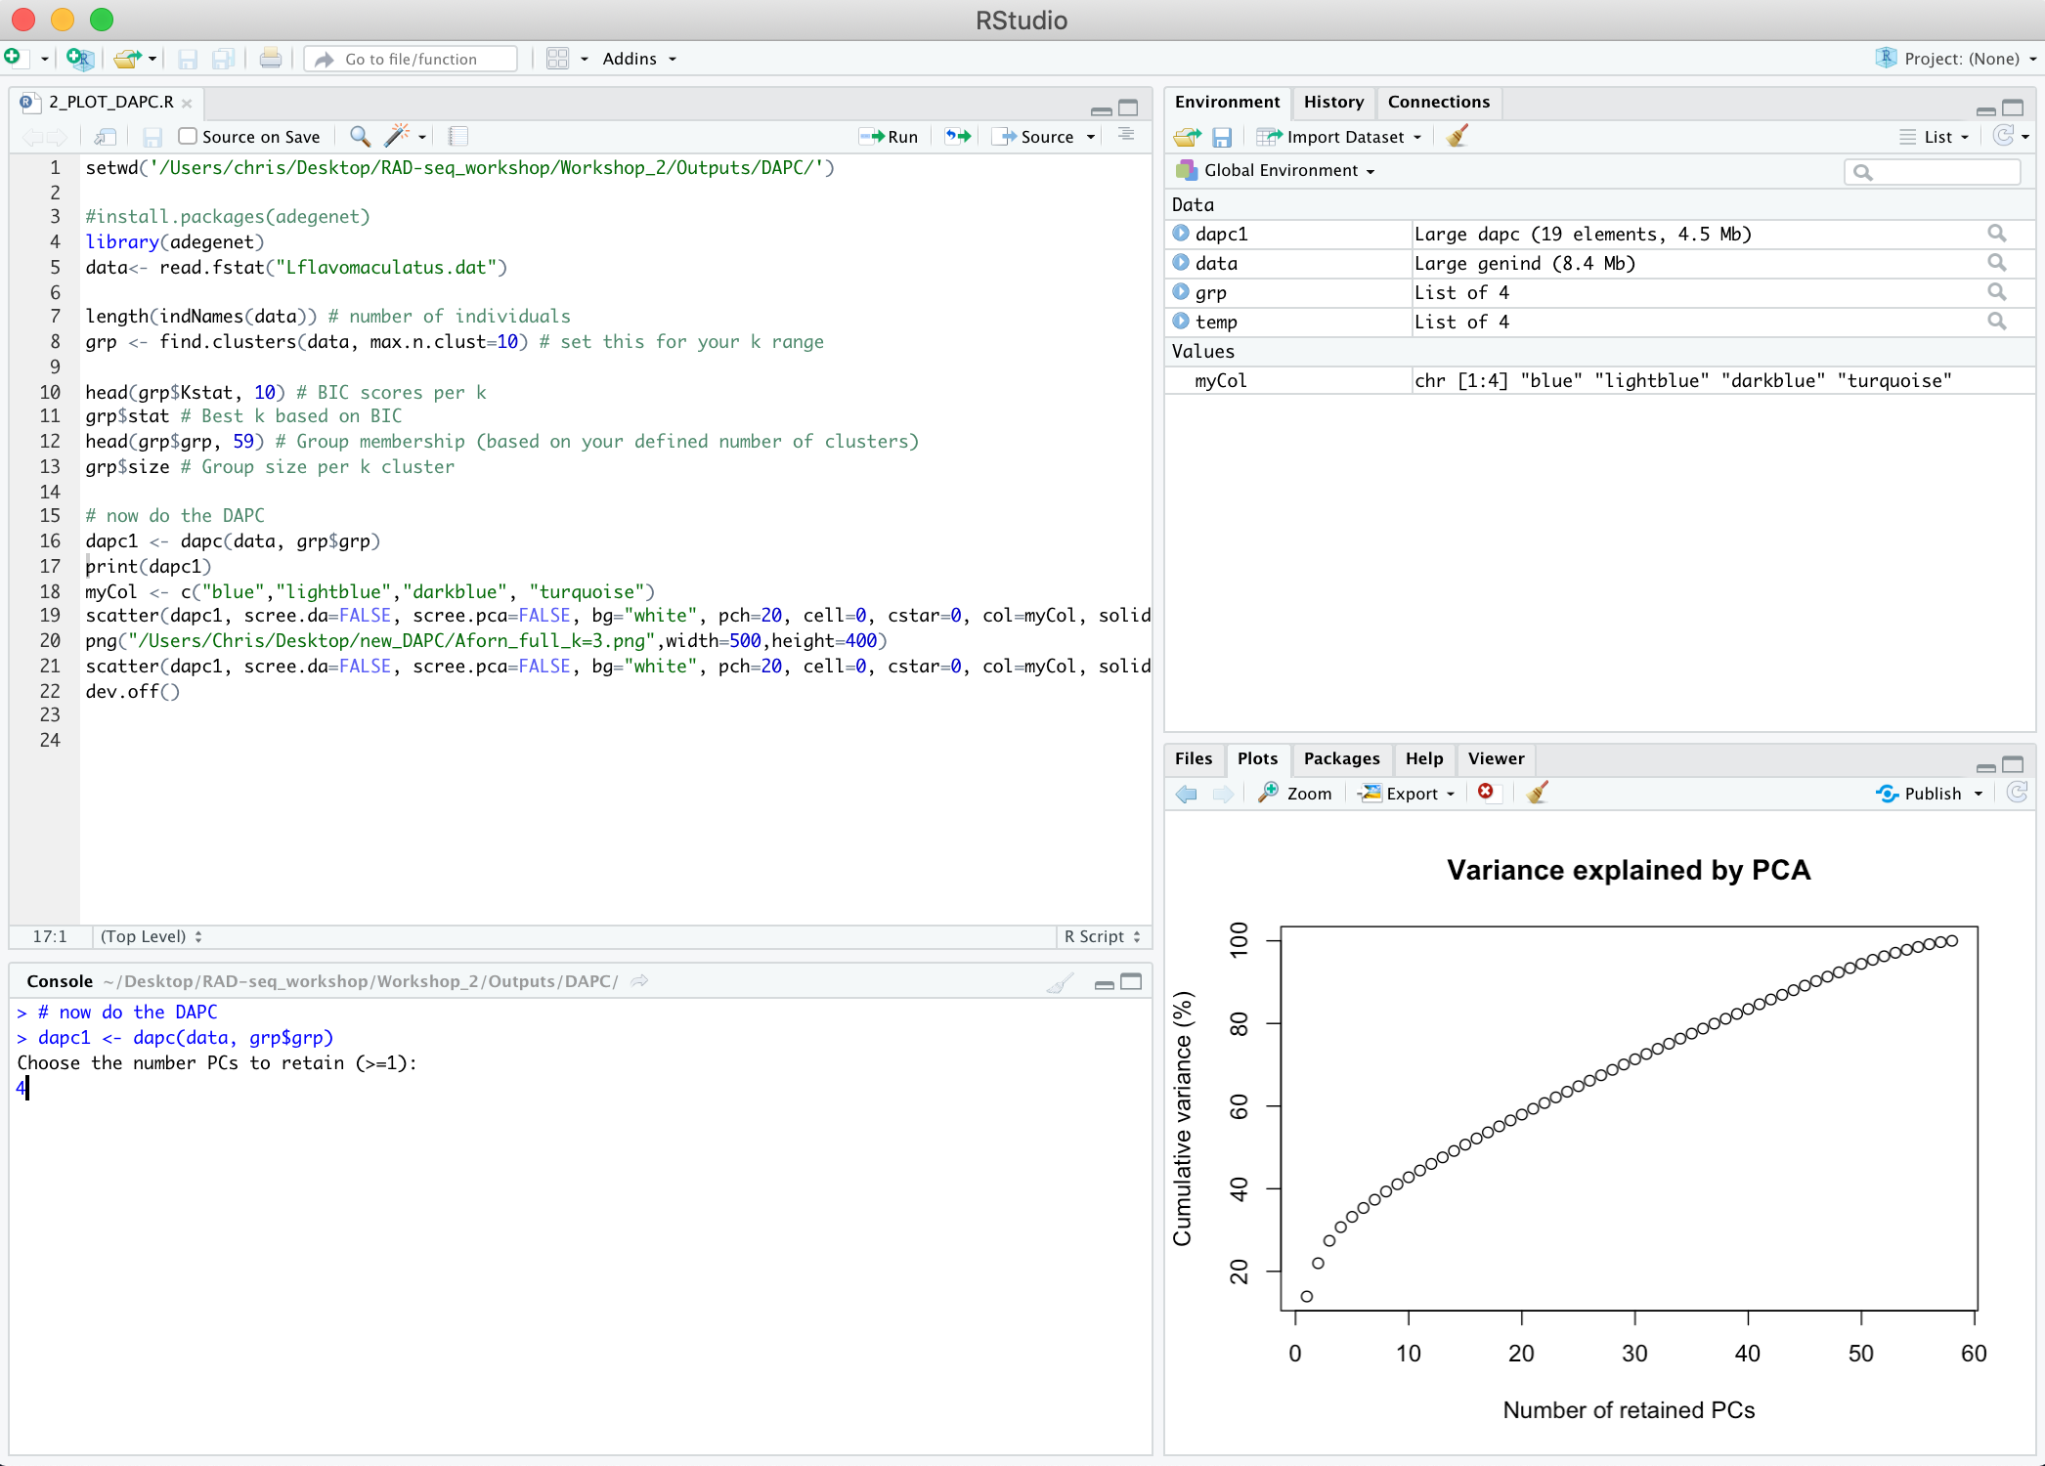
Population structure - DAPC
Choose how many PCs to retain (top of the initial upward curve)

Slide 30
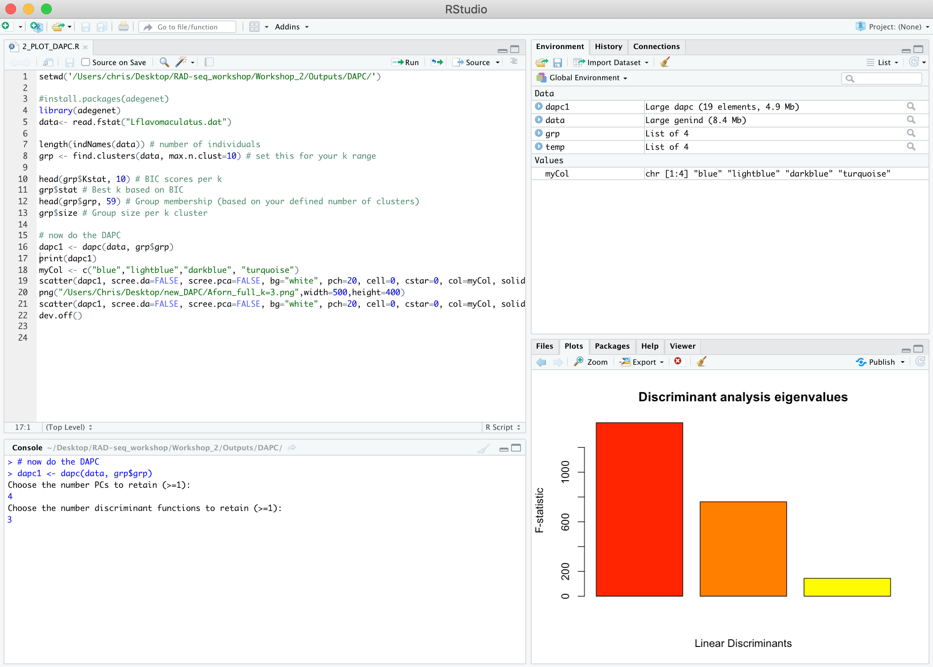
Population structure - DAPC
Choose how many discriminant functions to retain (in this case ,3)

Slide 31
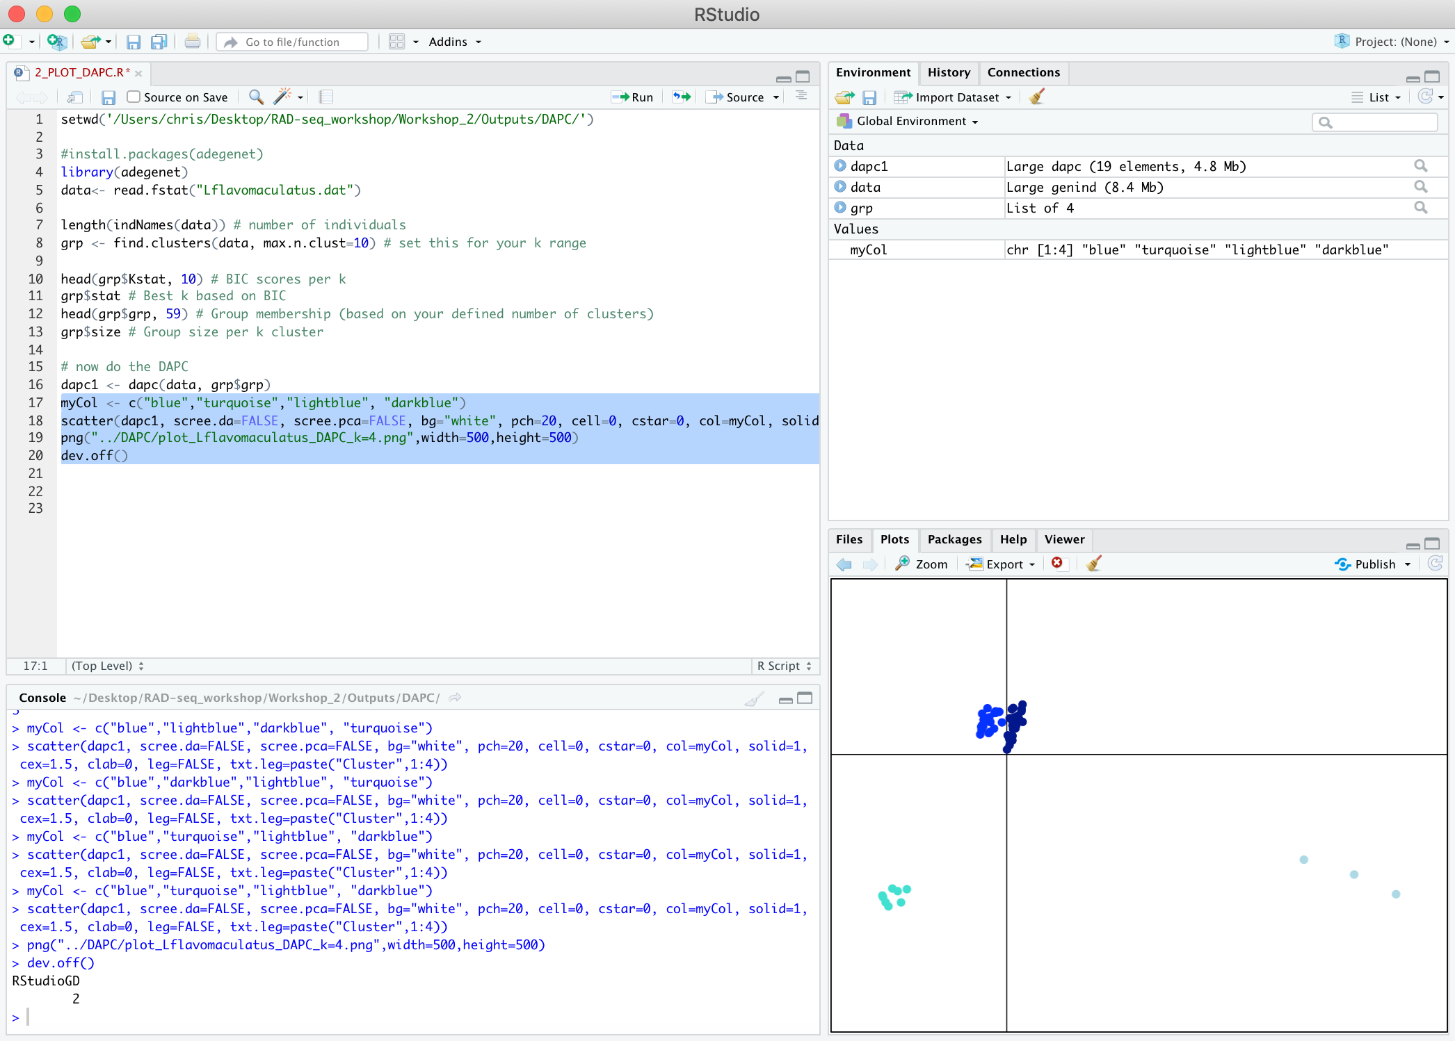
Population structure - DAPC
Lines 17-20 will plot the resulting PCA with 4 clusters

Slide 32
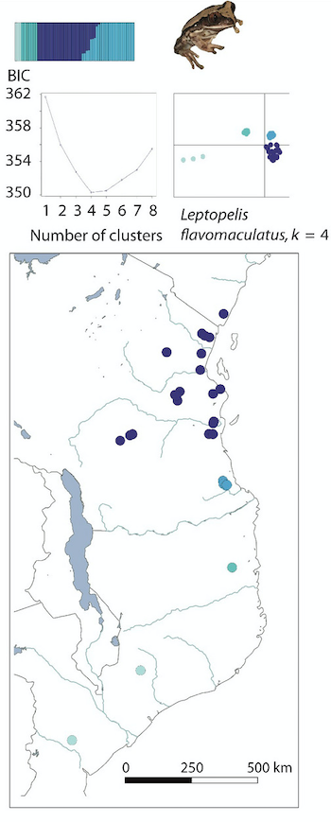
Population structure - summary
Both of our Admixture and DAPC analyses recover the same results, k=4…
1 isolated cluster towards southern Mozambique
1 cluster in northern Mozambique
1 cluster in southern Tanzania
1 large cluster in northern Tanzania and Kenya

Slide 33
Phylogenetic relationships
So now we have an idea of the structure of this data, but what about the evolutionary relationships between populations?
For our later demographic modelling this is essential to know, we need to get the shape of our models correct
?
?
?

Slide 34
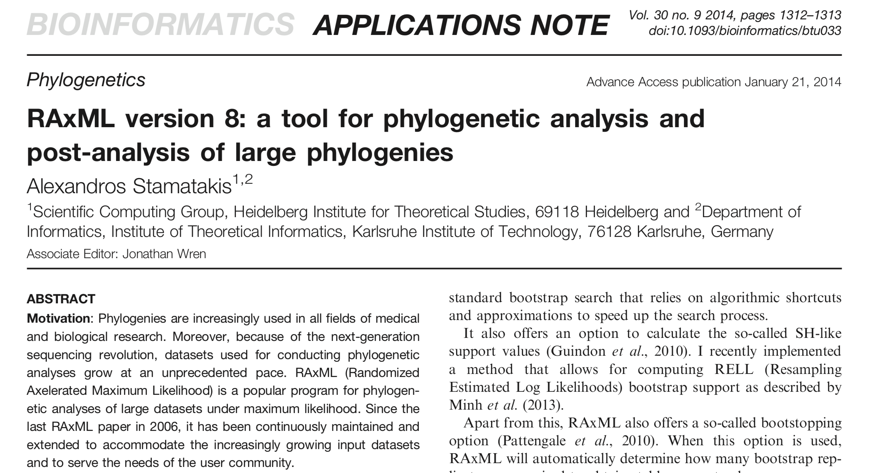
Phylogenetic relationships - RAxML
A simple start to look how relationships between individuals and populations is with RAxML (Stamatakis, 2014)
What is RAxML? A ML phylogenetic tool for visualising evolutionary relationships

Slide 35
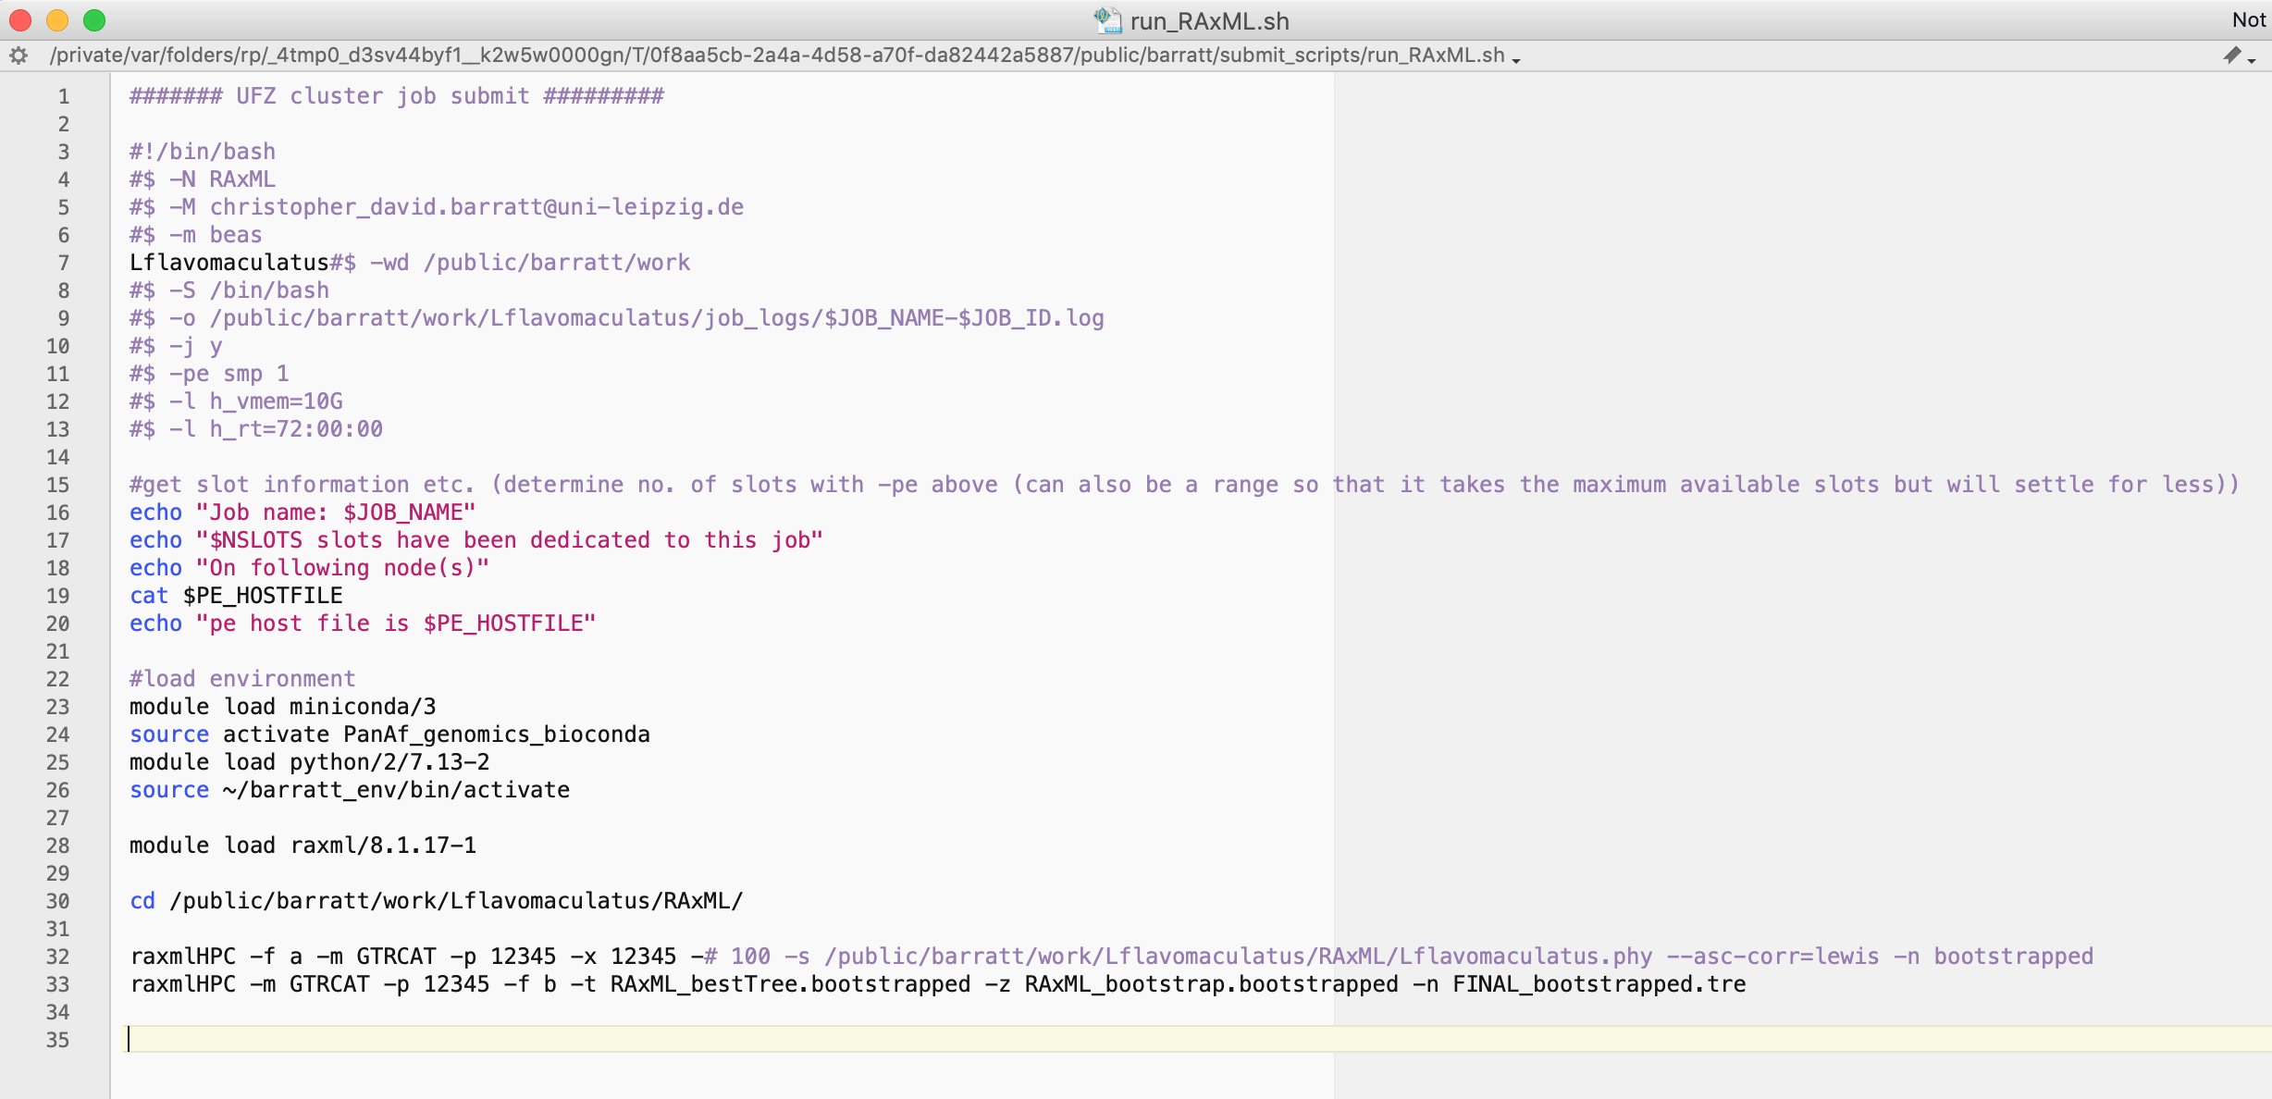
Phylogenetic relationships - RAxML
Your input file here is a phylip file (.phy, n=53 due to missing data)
You can submit this job to RAxML on the cluster with qsub run_RAxML.sh, or with the CIPRES gateway
First the ML search, then bootstrapping to a final tree

Slide 36
Phylogenetic relationships - RAxML
Your output files will be several - bootstrap files and also the final tree
Open the RAxML_bipartitons.FINAL_bootstrapped.tre in Figtree to see the results of the relationships (say ok to the label question)
Open ‘Trees’ on the left panel, click ‘Root Tree’ and select ‘Midpoint’ (We do this because we have no outgroup in this dataset)
If you want more informative labels click File>Import Annotations and import RAD_IDs.txt from Input_files/RAxML folder
Then in “Tip labels” choose Display as “NEW NAME”

Slide 37
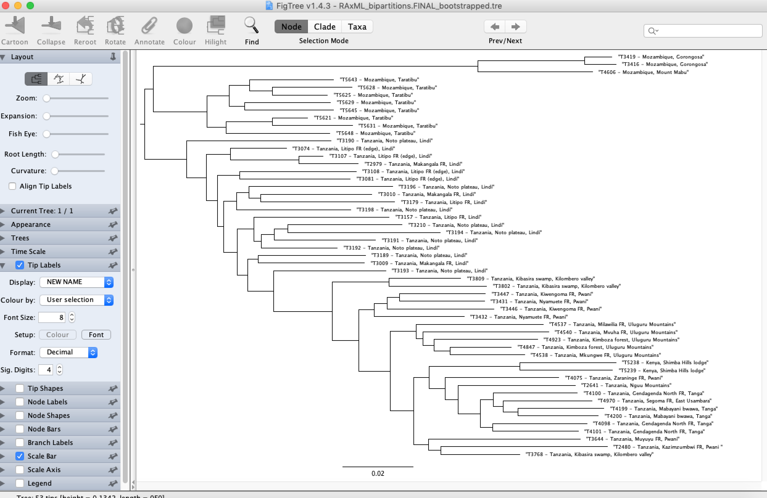
Phylogenetic relationships - RAxML

Slide 38
Phylogenetic relationships - RAxML
Important caveat 1 – RAxML is phylogenetic software, so if your data are populations within species, or closely related species then other coalescent-based methods are much more suitable (which we will now do)
Important caveat 2 – RAxML seems to perform better with full RAD-seq loci, not just single SNPs. Computationally this is more intensive but bootstrap scores are much better when you supply the full sequence of each RAD locus

Slide 39
Phylogenetic relationships - SNAPP
What is SNAPP? A (relatively) rapid algorithm for looking at evolutionary relationships between populations using multi-locus SNP data
Based on the backwards in time multispecies coalescent model, it integrates separate gene trees together for all of your SNPs
Only feasible for a relatively small number of species due to the mathematical intensity of the gene tree integration (but perfect for shallow phylogenies or population structure)

Slide 40

Phylogenetic relationships - SNAPP
Built as an add-on package to the popular BEAST software (Bryant et al. 2012)

Slide 41
Phylogenetic relationships - SNAPP
I thinned our nex file (Lflavomaculatus_thinned.nex) - SNAPP is very computationally intensive
From each of the 4 populations identified earlier there are 3-4 representative individuals, each with 8598 SNPs (missing data=N)
We will use BEAUti (part of the BEAST package) to build the xml file for this which SNAPP needs to run
Keep in mind we only have a few thousand SNPs (~8500) because I filtered quite strictly during our processing in Stacks. If you have hundreds of thousands/millions of SNPs from other types of data then you will need to assemble your xml file bioinformatically (BEAuti will just freeze)

Slide 42
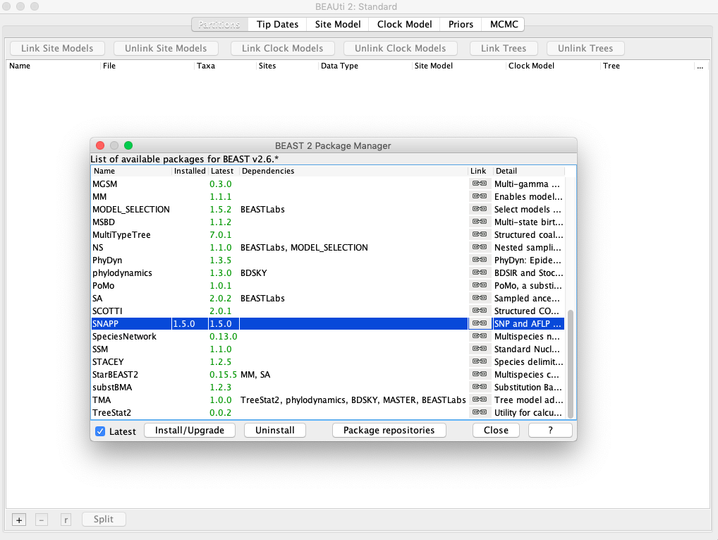
Phylogenetic relationships - SNAPP
First, open BEAUti and go File>Manage Packages, scroll to SNAPP and install

Slide 43
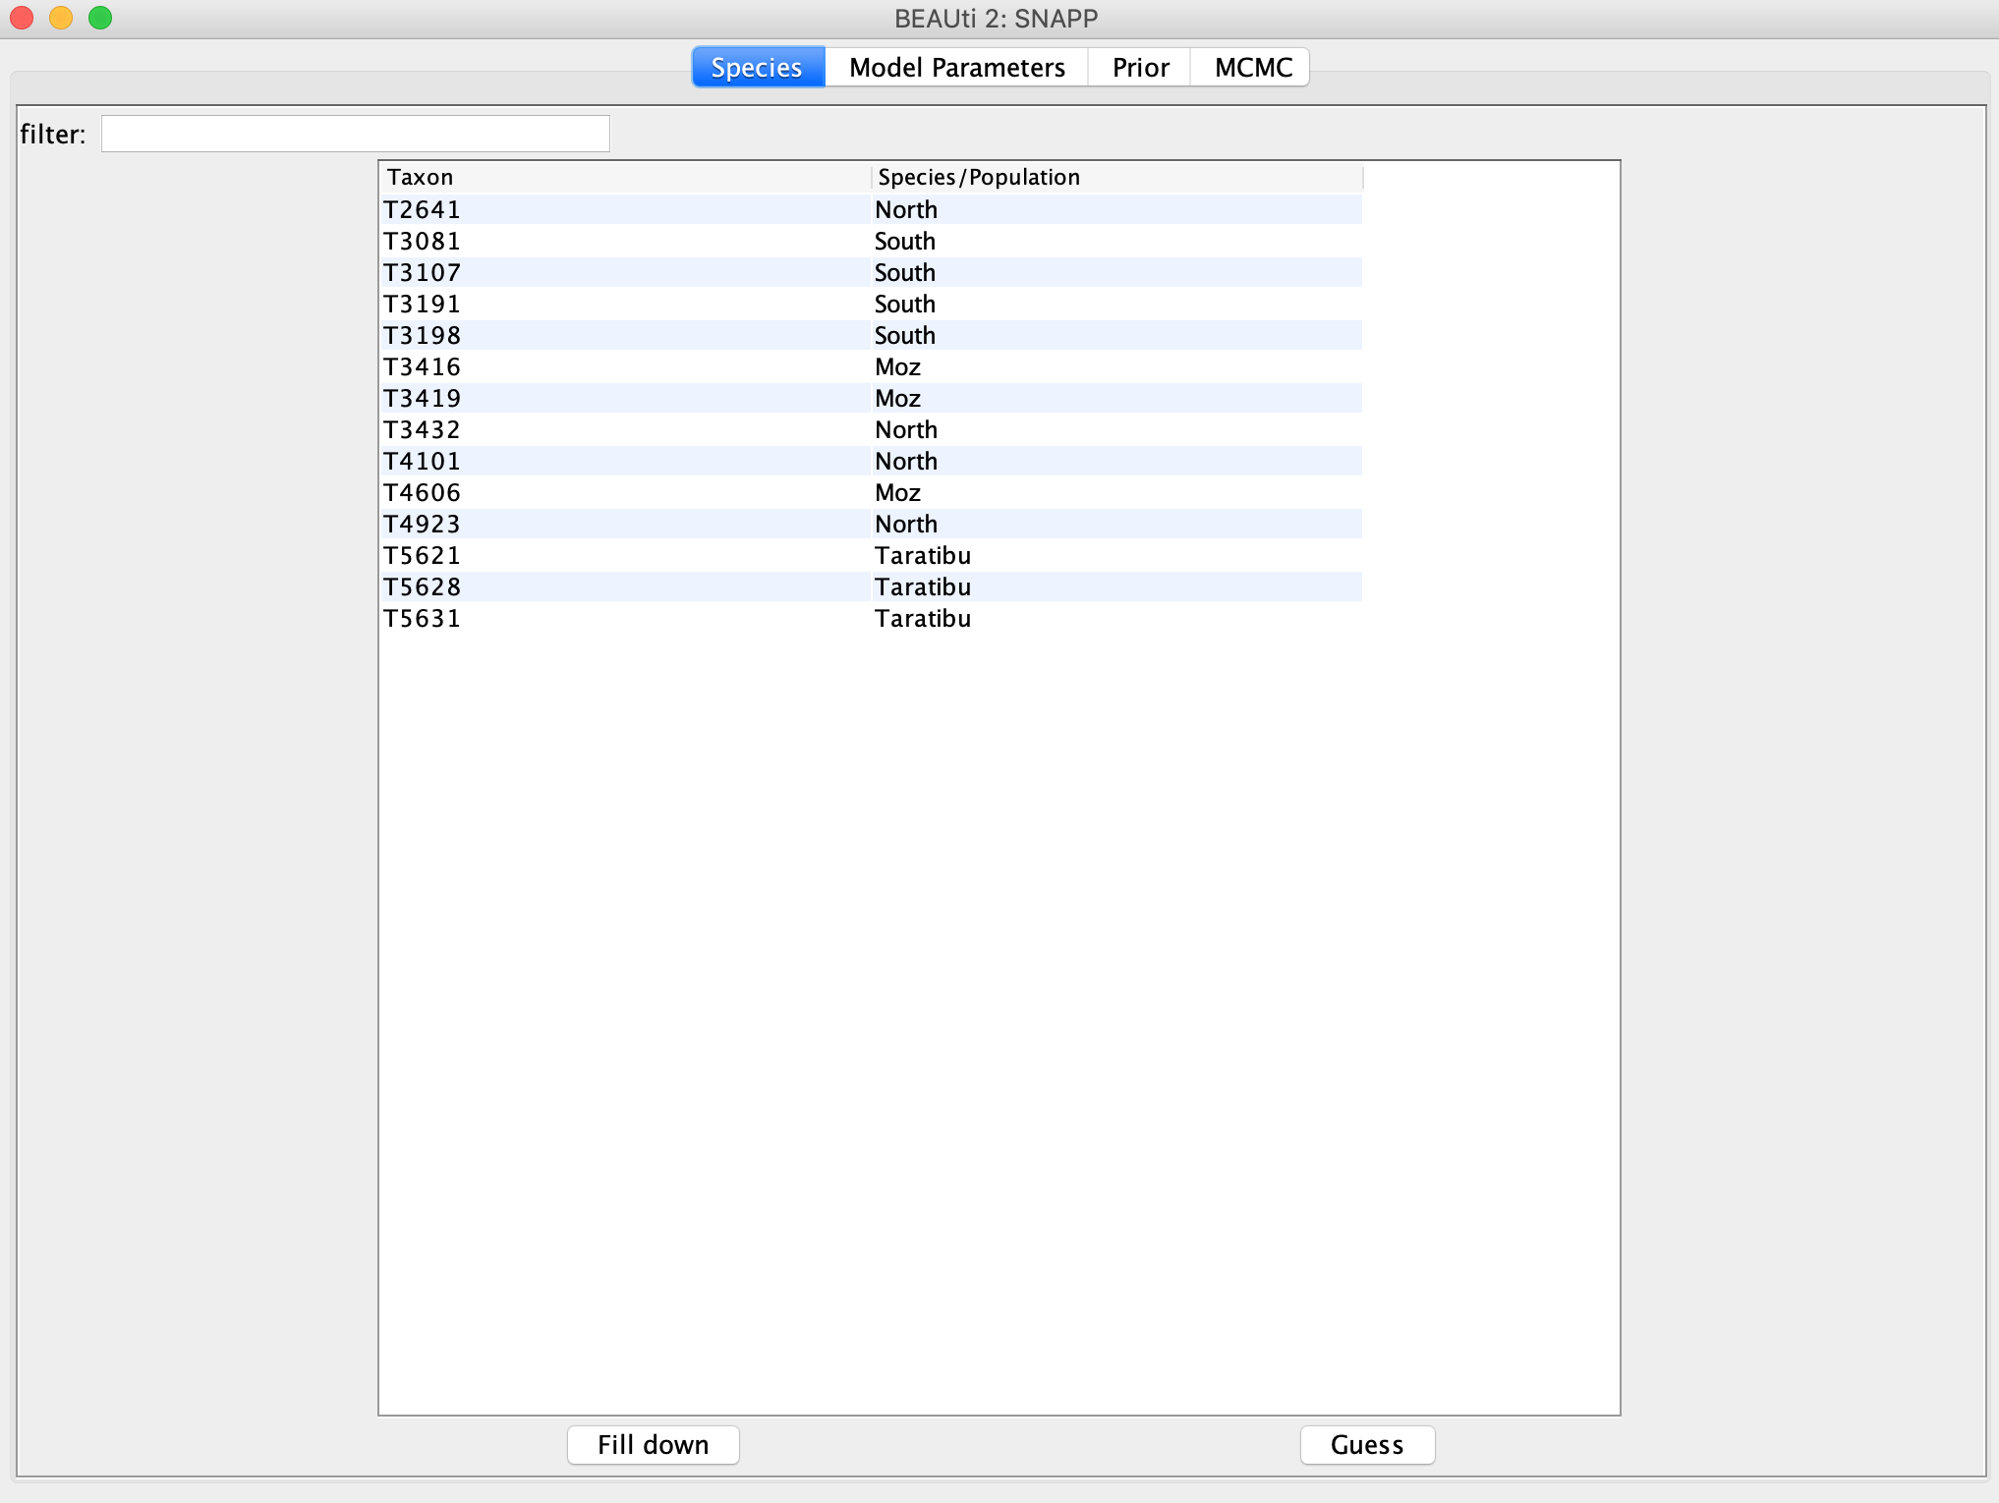
Phylogenetic relationships - SNAPP
Go to File>Template>SNAPP
Now go File>Import Alignment and select the thinned nexus file
We need to tell SNAPP which individual belongs to which population, so fill in as below (don’t leave any invisible spaces)

Slide 44
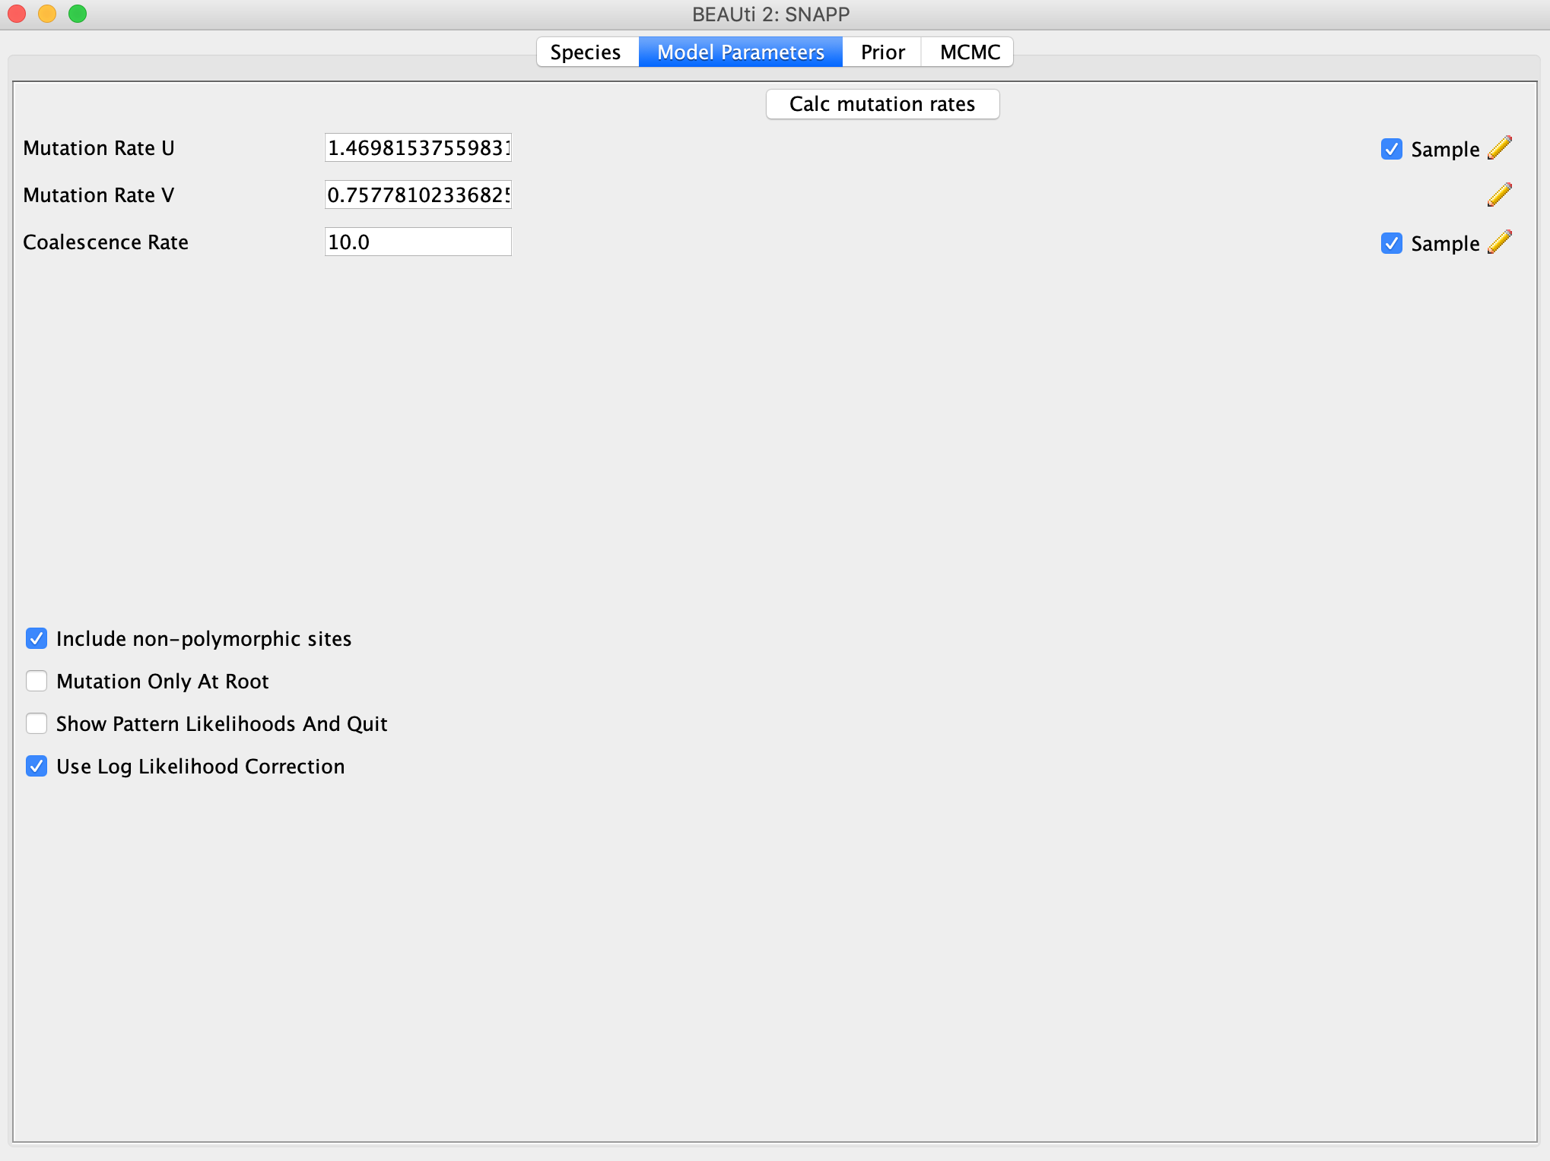
Phylogenetic relationships - SNAPP
Click on the Model Parameters tab and calculate mutation rates button (calculates from the data)

Slide 45
Phylogenetic relationships - SNAPP
Leave the Prior tab as is for now, setting priors can be complex, but you could and should explore the effects of different priors on your output trees. The defaults are probably not suitable for your data
Click on MCMC and keep chain length at 1000000, change tracelog filename to Lflavomaculatus.log and treelog filename to Lflavomaculatus.trees. Each of these is logging every 1000 so your output files will have 1000 entries
Save as Lflavomaculatus_thinned.xml
You can check if it runs by opening BEAST and running this xml file. Cancel it after it begins to run. You can submit to CIPRES if you want to run yourself (setting up SNAPP on the UFZ cluster is time-consuming, we won’t go through that here, but the run_SNAPP.sh is there for you to take a look at)

Slide 46
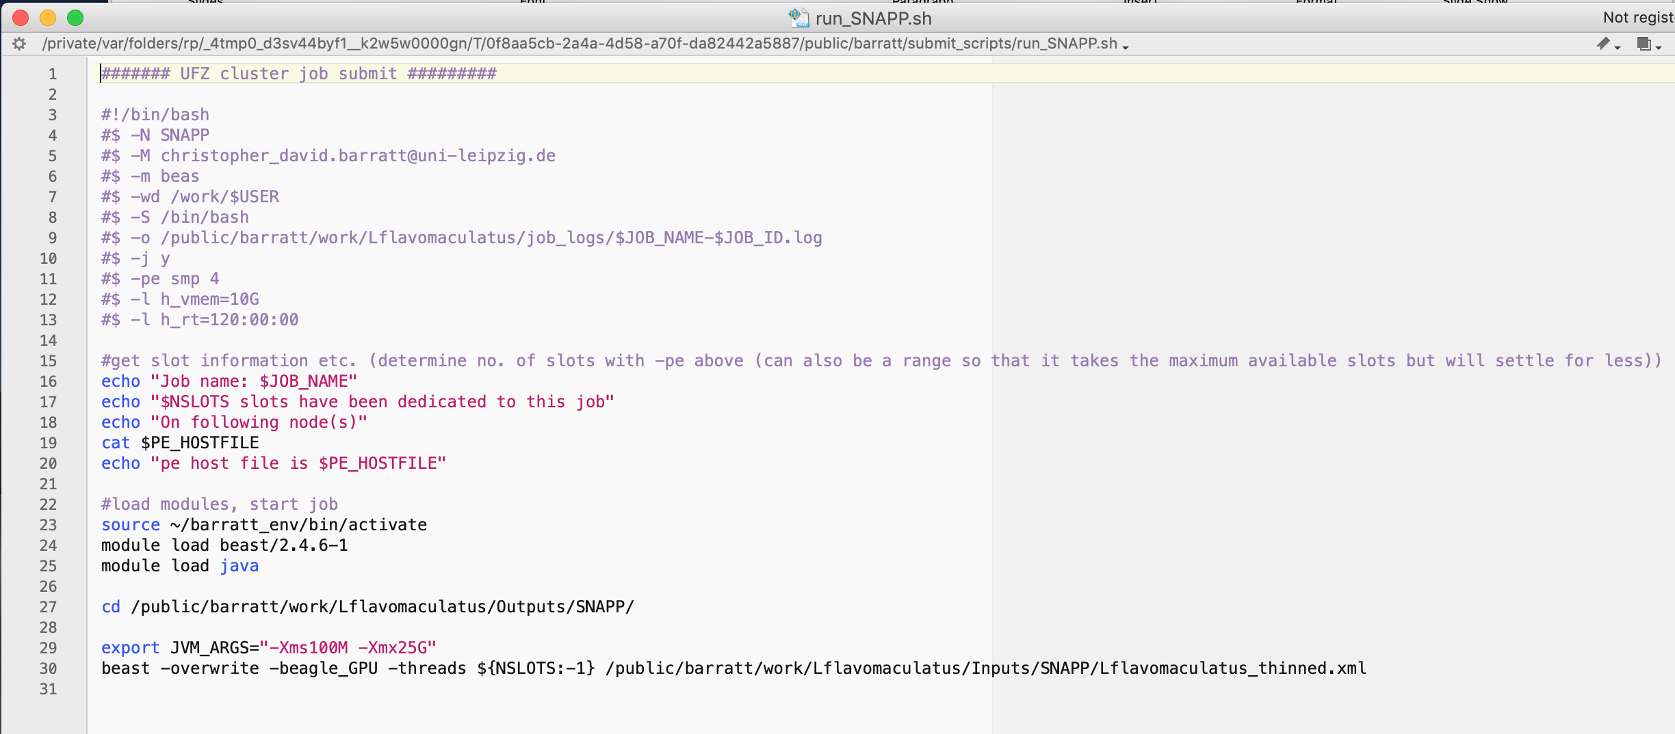
Phylogenetic relationships - SNAPP

Slide 47
Phylogenetic relationships - SNAPP
This will take 12-13 hours to run because of the calculations. Ideally you would have 10,000 tree and log entries for later on, but in this case I have just given 1000. I have the output files prepared for you… . log and .trees
Using Tracer you can check the log files to see how well they have converged. ESS scores (Effective Sample Sizes) above 200 are typically considered as sufficient (but are less here due to above)
Sometimes a BEAST run can get stuck in weird parameter space so you may need to rerun analyses to check that your results hold
Another consideration is to run the same analysis with different representative individuals (also to see if results are consistent)
Another more in depth tutorial can be found here

Slide 48
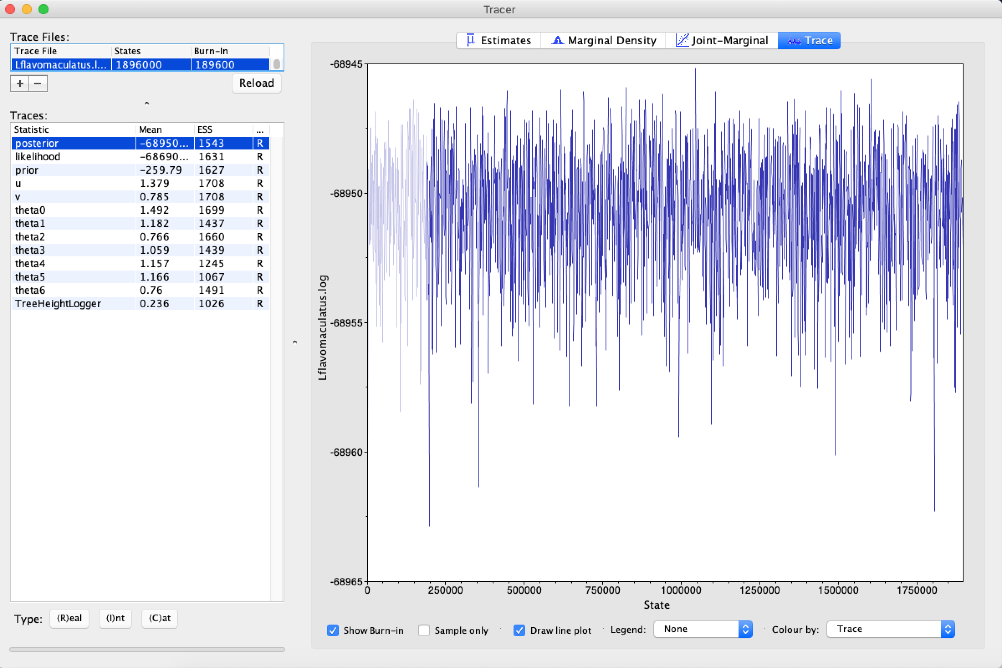

Phylogenetic relationships - SNAPP
Load the .log files in Tracer (part of BEAST package)
These are your 1000 logs. Typically you want your posterior ESS score to be over 200
Look at the trace tab and see if it is in the right parameter space. A fat caterpillar is what you want to see ☺

Slide 49
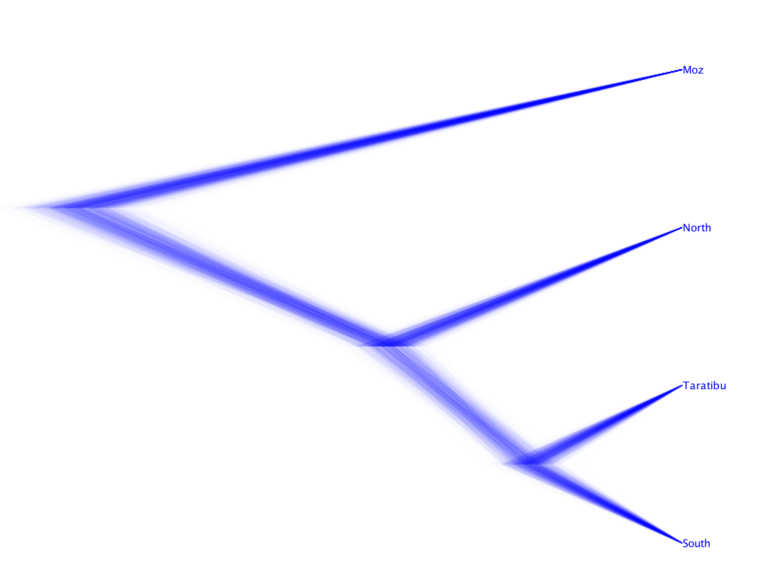
Phylogenetic relationships - SNAPP
Load the .trees file in DensiTree (part of BEAST package)
This is your 1000 trees and they all look consistent, which is very good!
You can see here how the populations are related to one another, based on 8598 SNPs

Slide 50
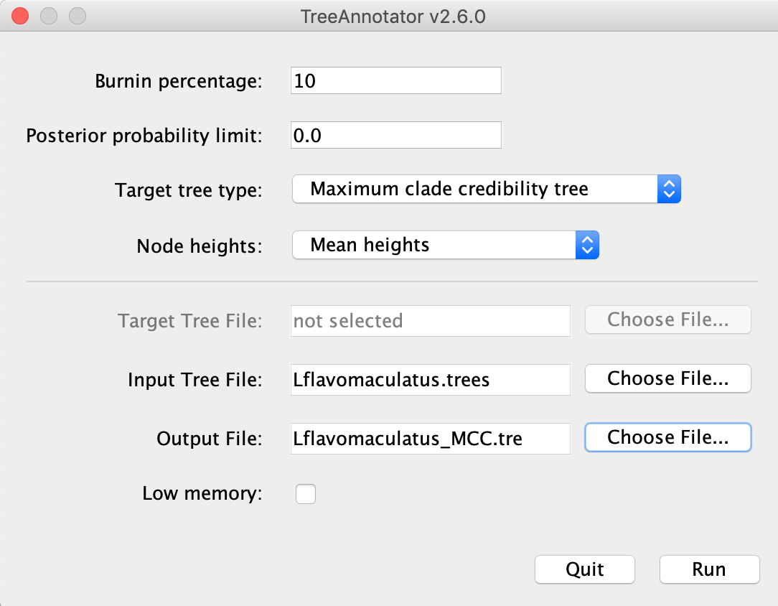
Phylogenetic relationships - SNAPP
From all your trees you can make a single MCC (Maximum Clade Credibility) summary tree…
Open TreeAnnotator (again part of BEAST package)
Set your burnin % (judge this by looking at Tracer plot on logfiles), specify your input trees file and call your output a .tre file

Slide 51
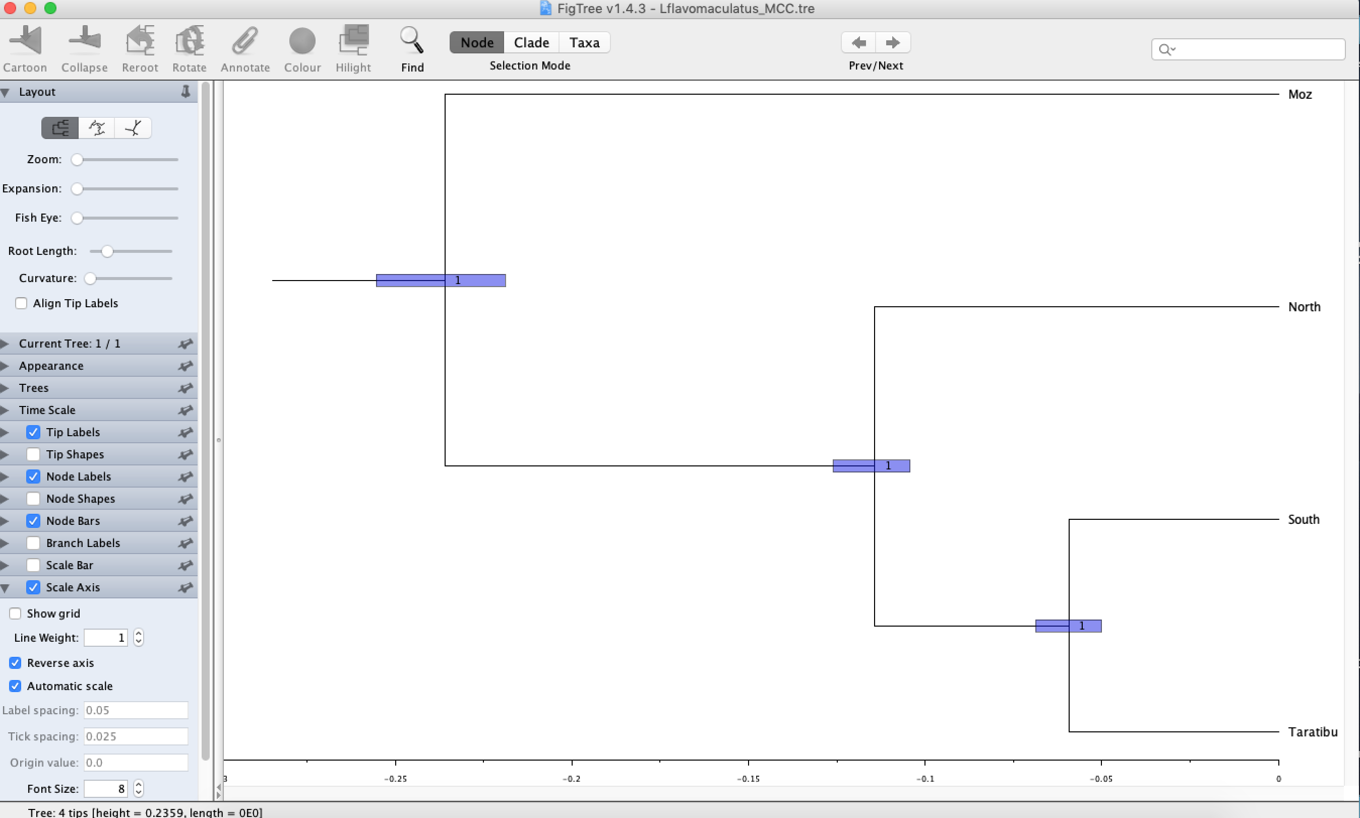
Phylogenetic relationships - SNAPP
Open your output tree file in FigTree or some other tree drawing visualisation software…
If you have an accurate and relevant mutation rate you can convert the dates of population splits (1 x 10-8, Lynch 2010, PNAS)
So here -0.1 would represent 1 million years (0.1 x 10-8)

Slide 52

That was a lot of info. Let’s have a cup of coffee…

Slide 53
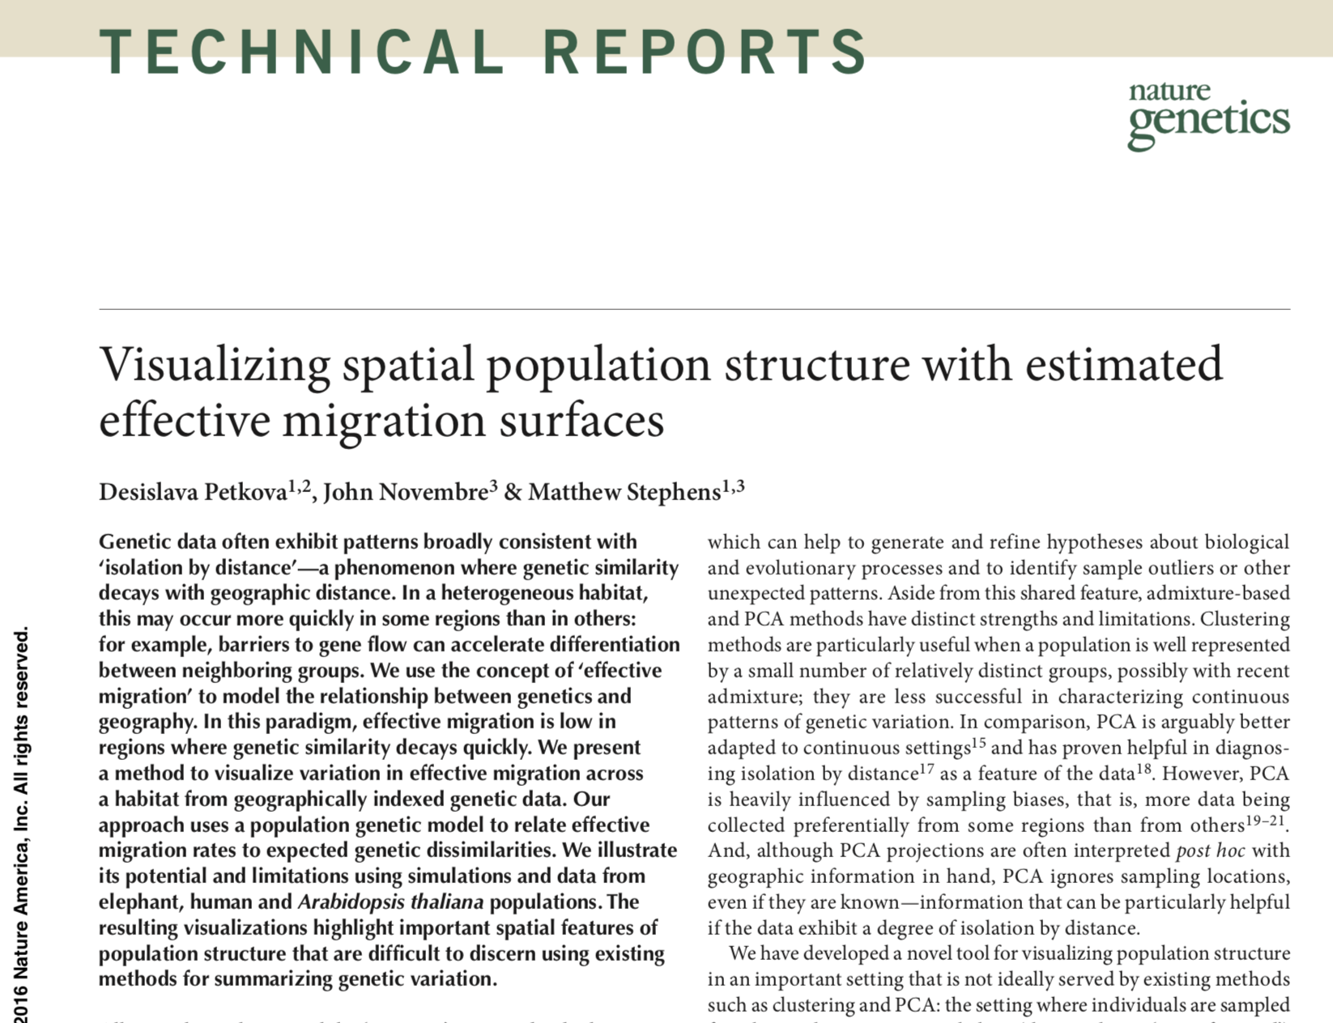
Landscape connectivity and barriers - EEMS
What is EEMS? Estimated Effective Migration Surfaces – a way to visualise connectivity and barriers across the sampling region using FST derived metrics (Petkova et al. 2016)

Slide 54
Landscape connectivity and barriers - EEMS
Assumption that genetic similarity between samples decays with geographic distance
This is complex in space and time but the basic premise is that a barrier would increase differentiation (=reduced gene flow)
They apply a population genetic model to relate genetic dissimilarity (FST) to effective migration rates
Essentially what the method does is computes haplotype sharing between sites and then interpolates these across geographic space so you can visualise potential barriers and areas of high gene flow

Slide 55
Landscape connectivity and barriers - EEMS
EEMS needs similar files to Admixture but with some additional extras. Firstly it needs the .count, .diffs and .order file which the first lines of the 3_RUN_EEMS.sh script generates from the ped and bed files
Secondly, EEMS also requires a .coord file (location info for each individual) and an .outer file to spatially bind the analysis (generated here:http://www.birdtheme.org/useful/v3tool.html)
The second part of the script is actually running EEMS, so you can open terminal, cd to the proper directory and and type bash 3_RUN_EEMS.sh followed by enter
This will take ~4 hours to run (2 x 1000000 MCMC runs, you can reduce if you want)

Slide 56
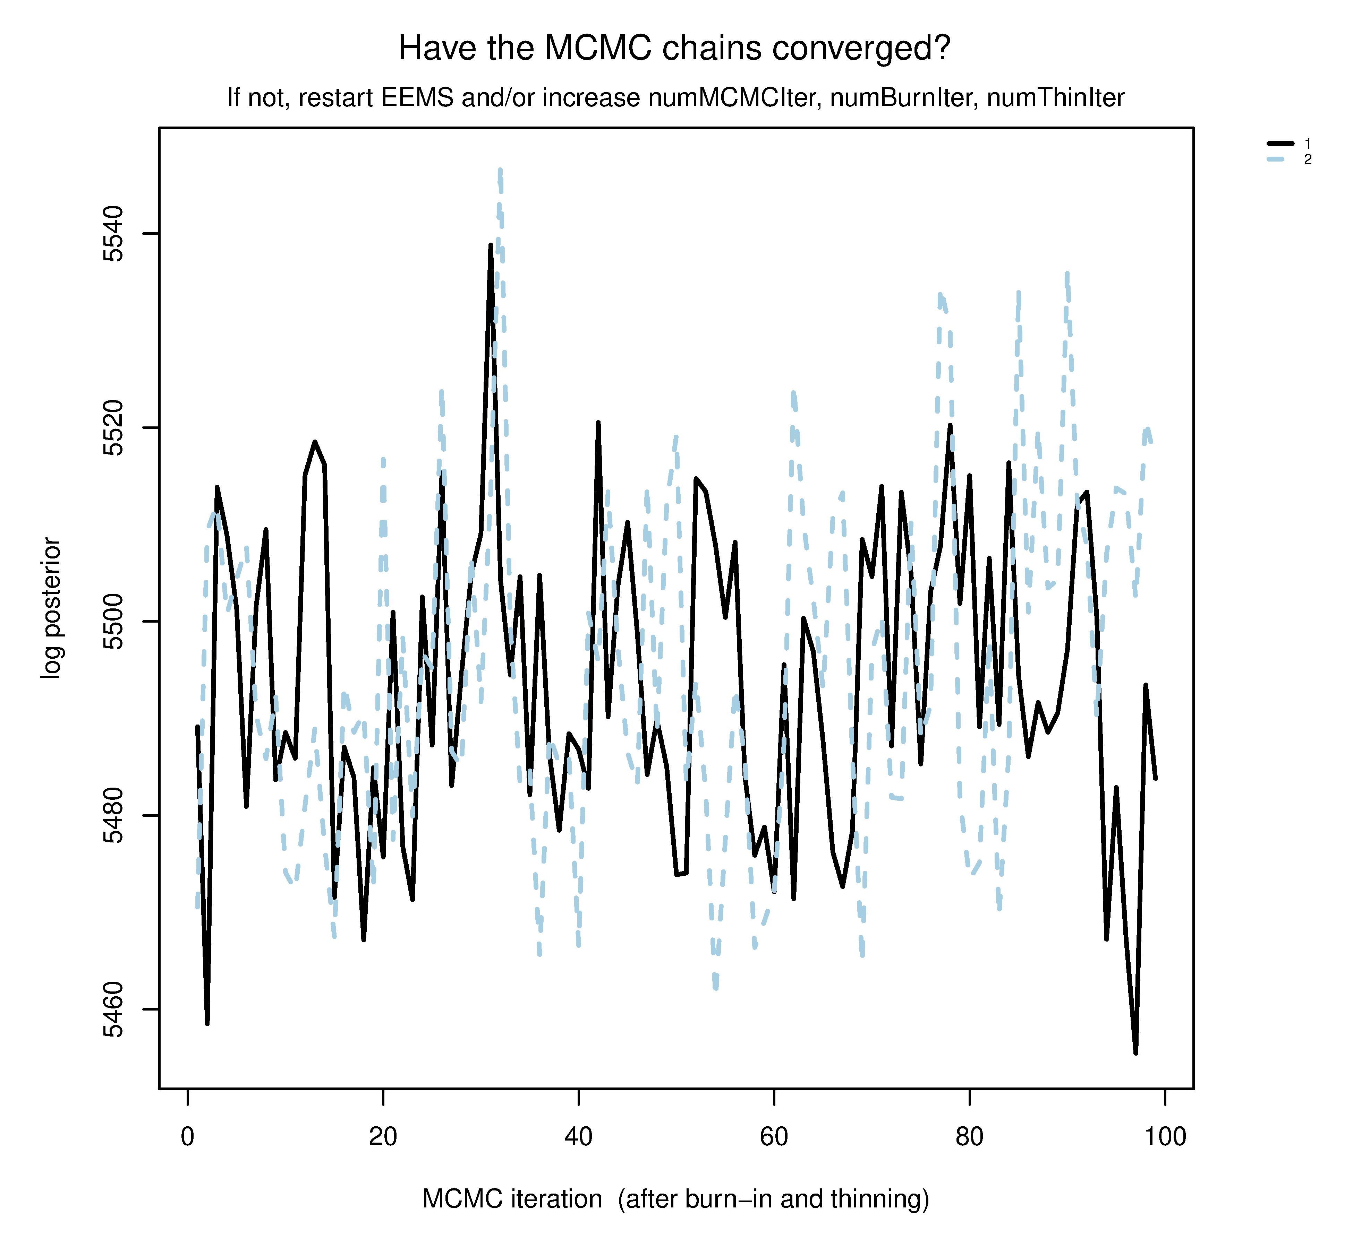
Landscape connectivity and barriers - EEMS
We can plot the results of this with the 3_PLOT_EEMS.R script – many output files will be generated, most of which are used to build the important images, so let’s focus on the main 3
pilogl01.png
Have the 2 MCMC runs converged?
This looks fairly ok, not perfect but not too bad…

Slide 57
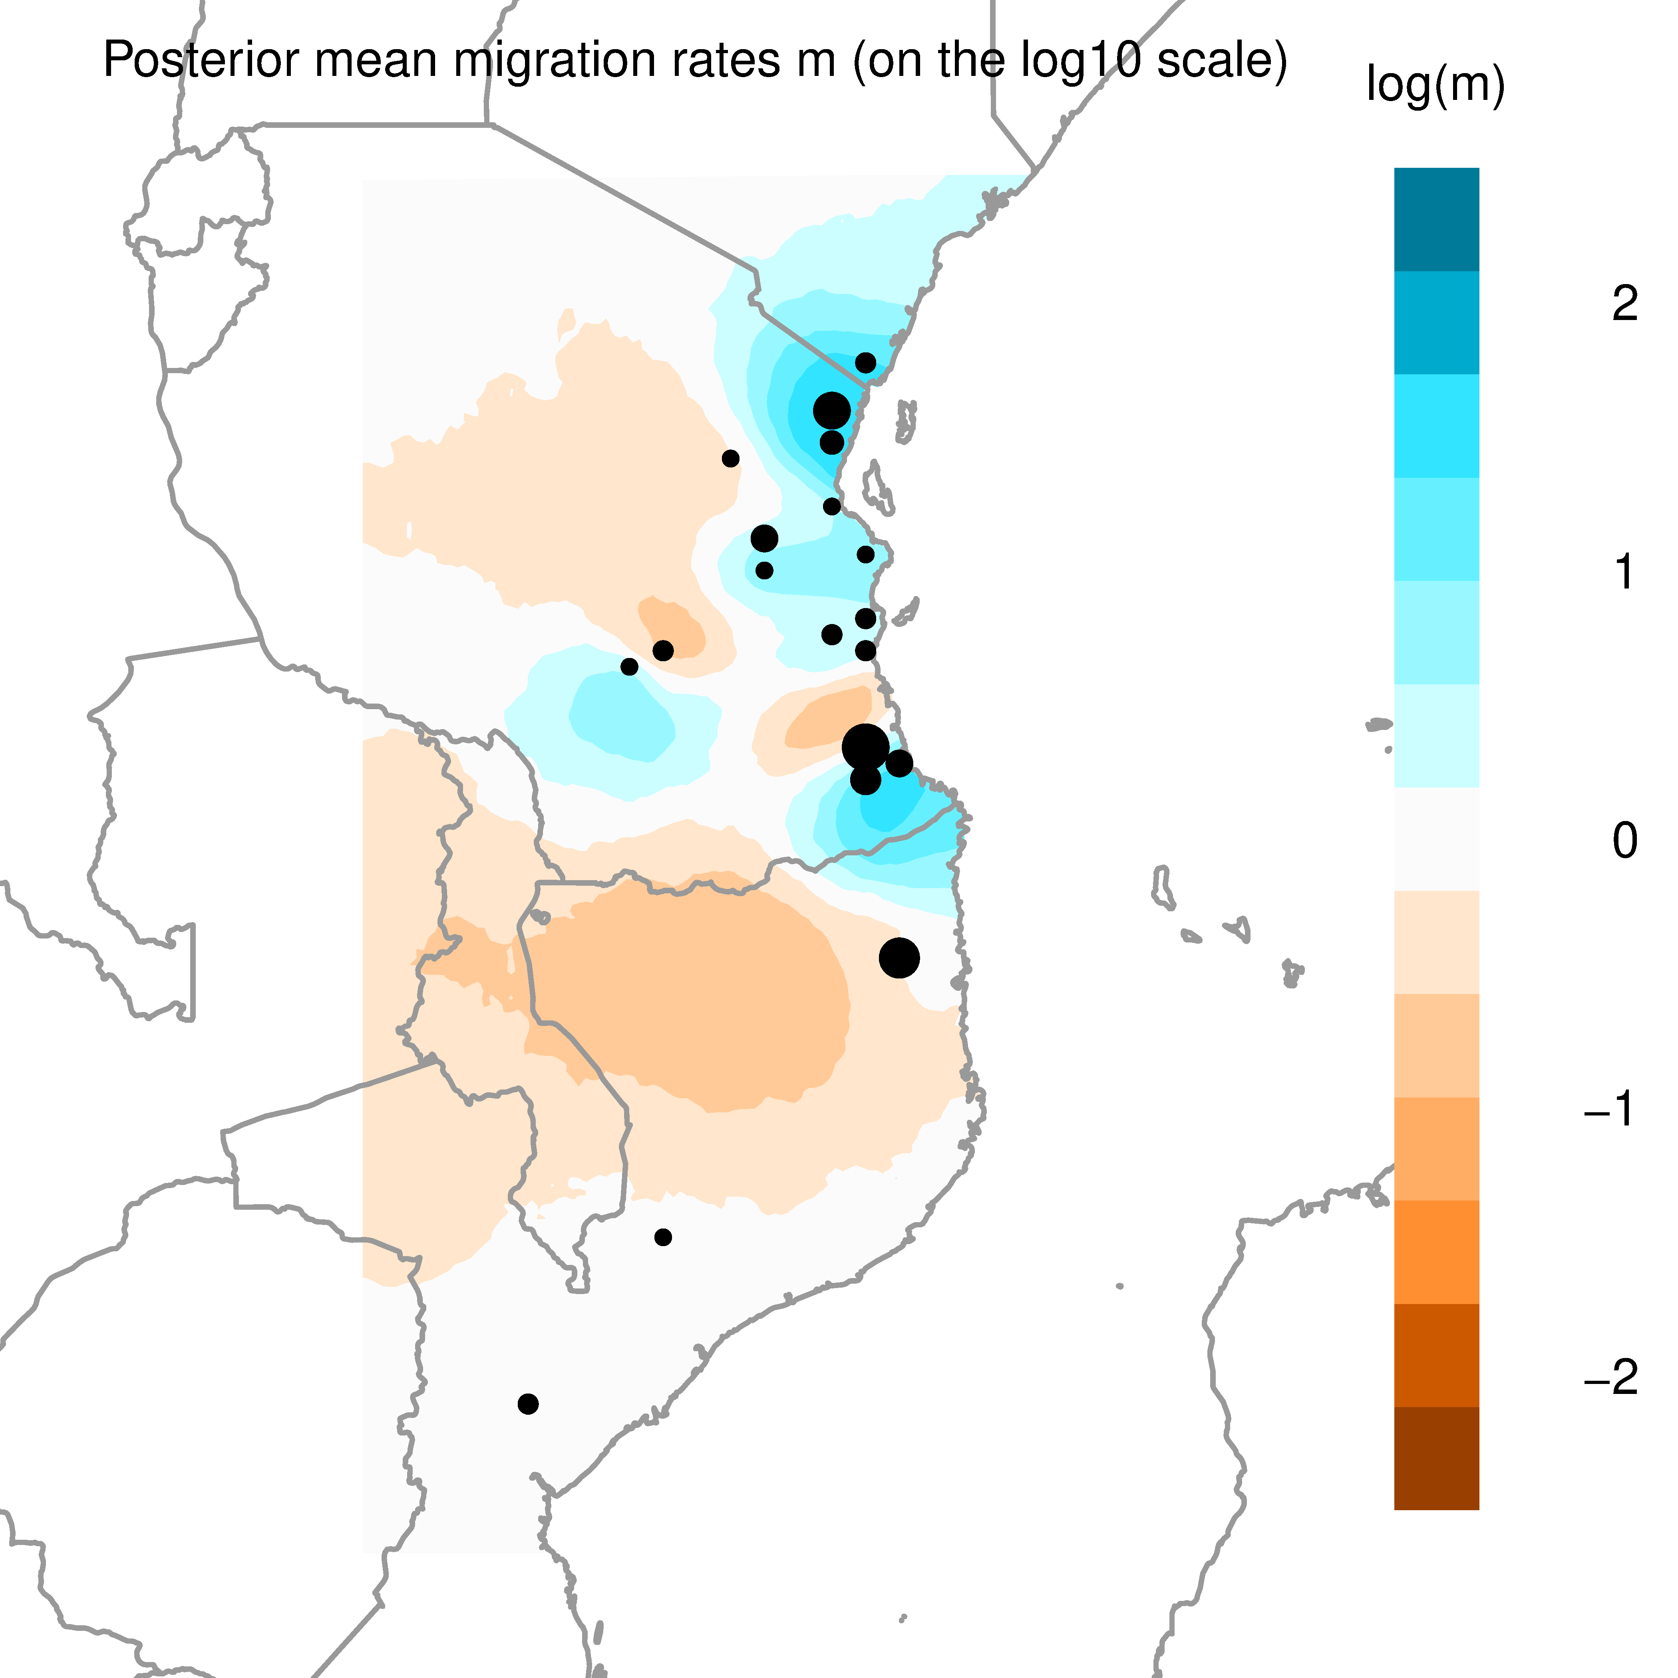
Landscape connectivity and barriers - EEMS
We can plot the results of this with the 3_PLOT_EEMS.R script – many output files will be generated, but lets focus on the main 3
mrates01.png
Blue = higher migration
Orange = lower migration

Slide 58
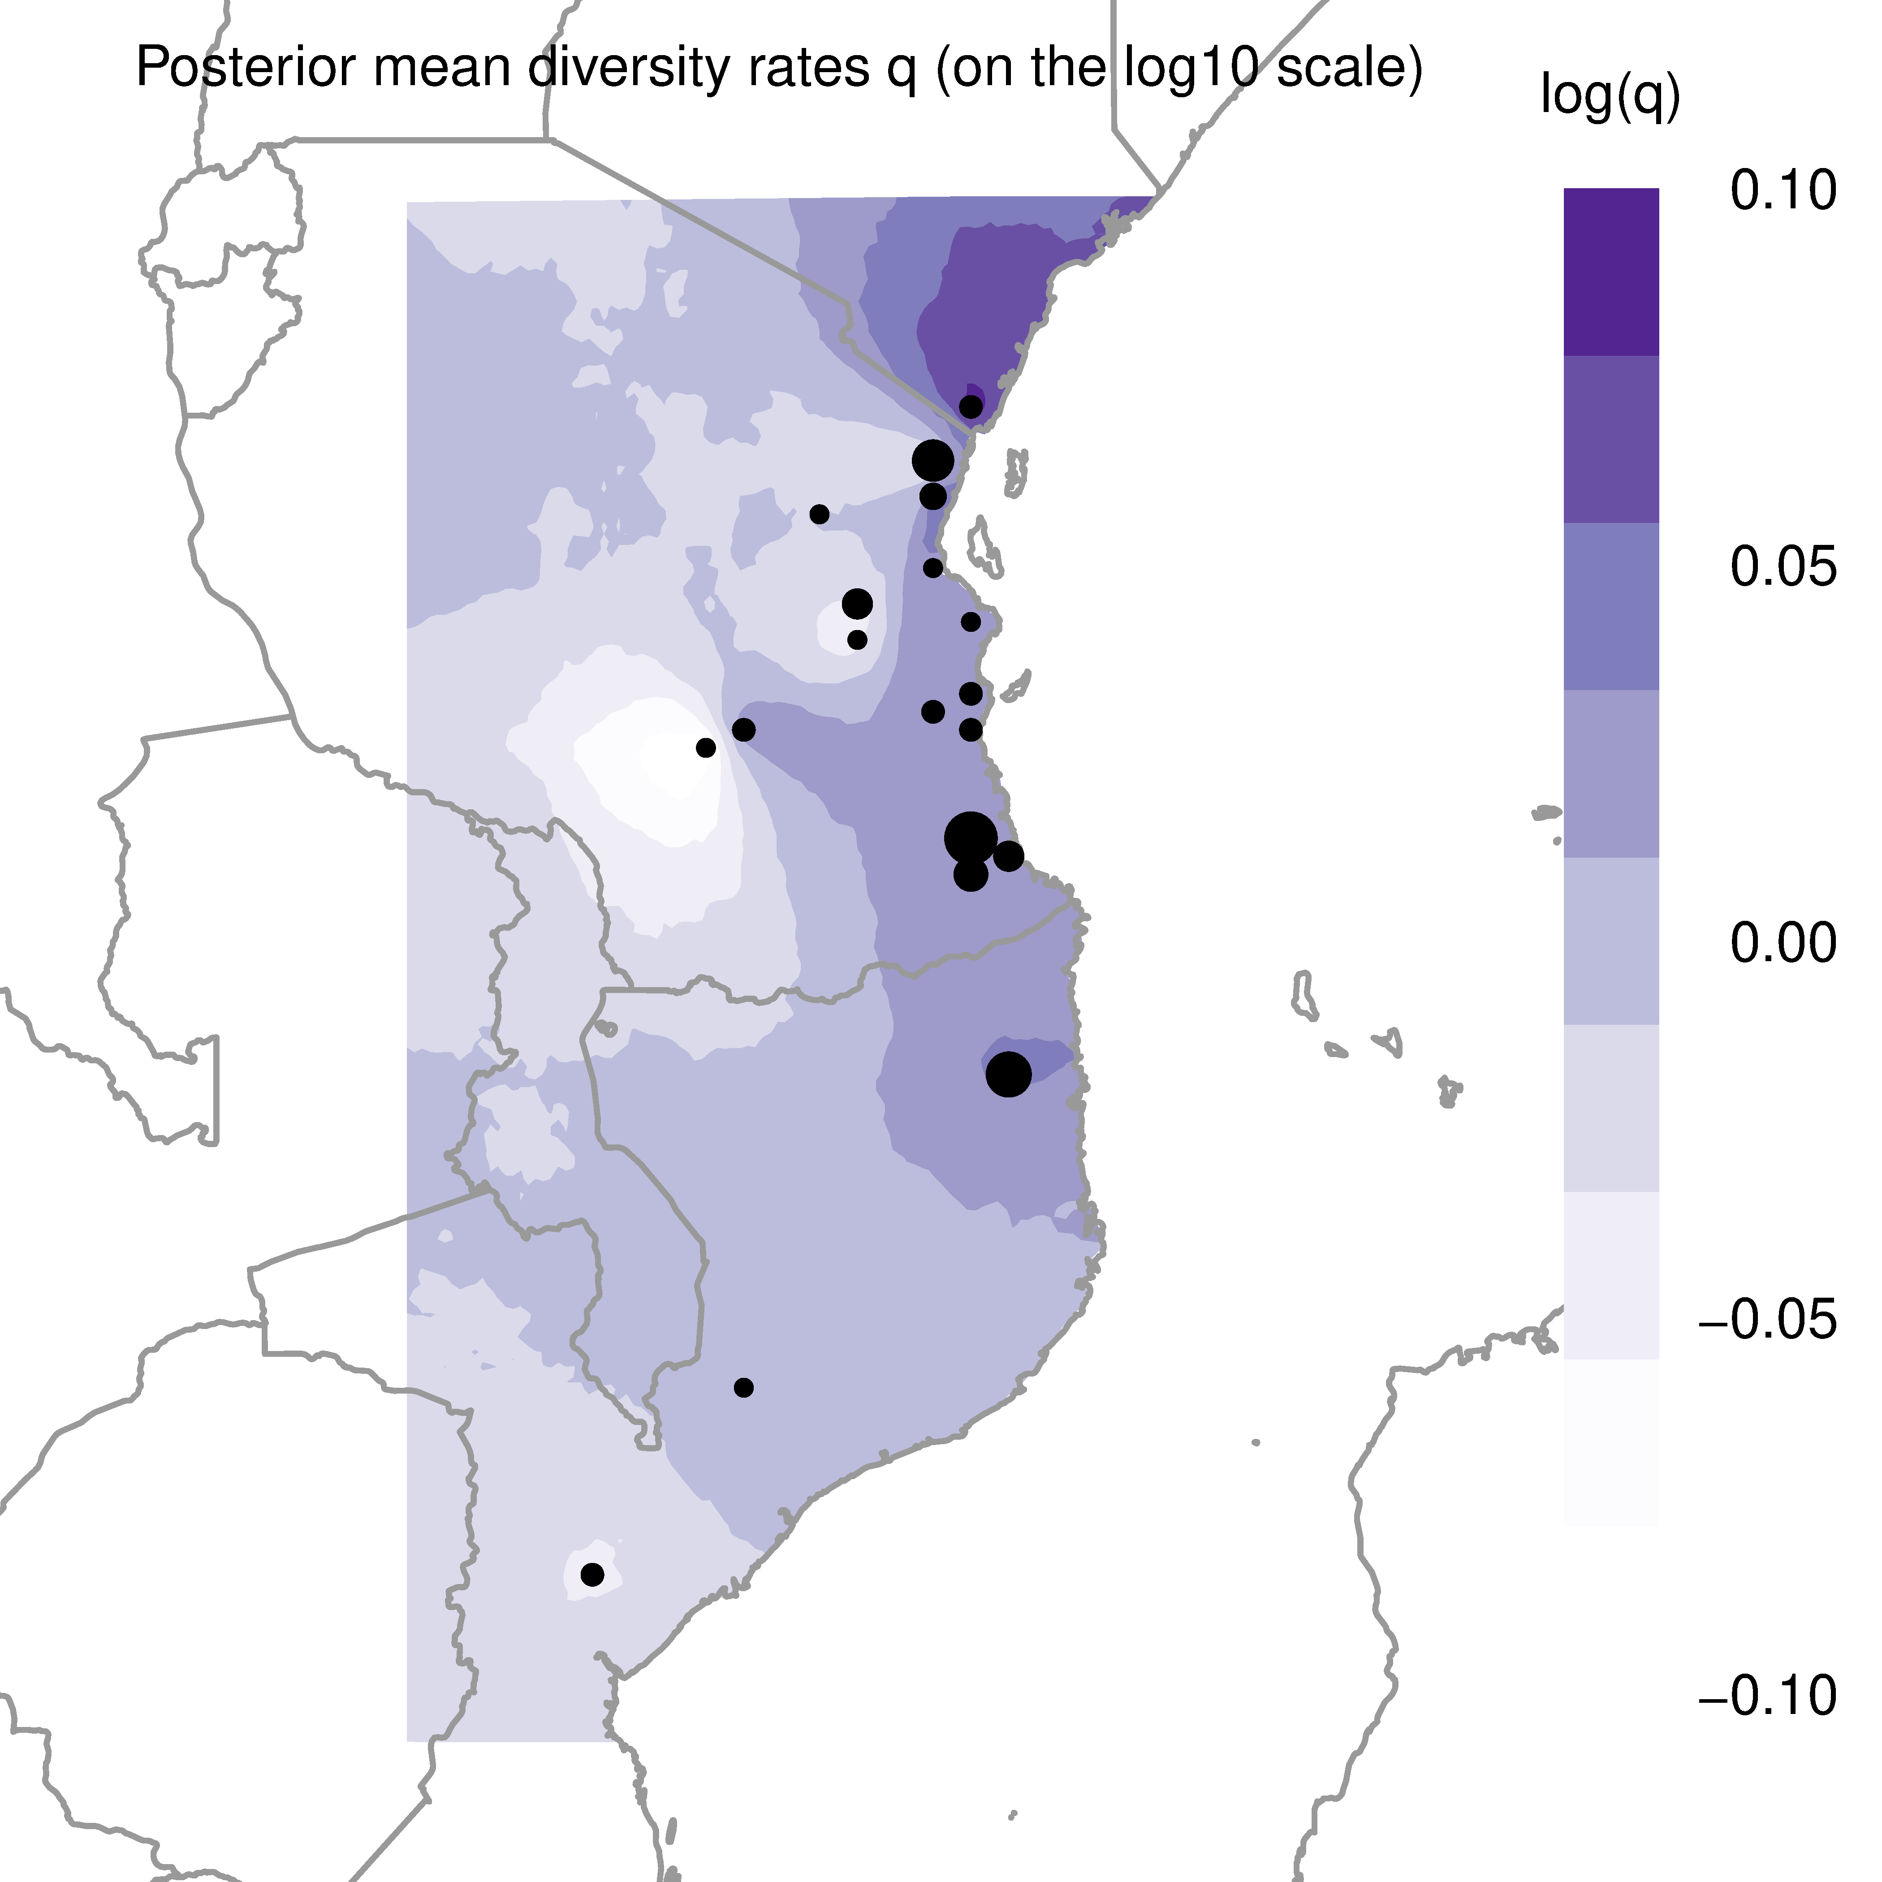
Landscape connectivity and barriers - EEMS
We can plot the results of this with the 3_PLOT_EEMS.R script – many output files will be generated, but lets focus on the main 3
C2 - qrates01.png
Purple = higher diversity
White = diversity

Slide 59
Landscape connectivity and barriers - EEMS
Should run EEMS for longer MCMC chains (we have done 1 million iterations here, should be at least 5 million)
We also ran two independent chains (2 .ini files) and take the results from both – providing they are sampling similar parameter space (have the chains converged?)
Deme size should also be examined, we chose 700 here because I know this data. I had experimented with 100, 250, 500, 1000, 5000 to see how localities became merged in the results

Slide 60
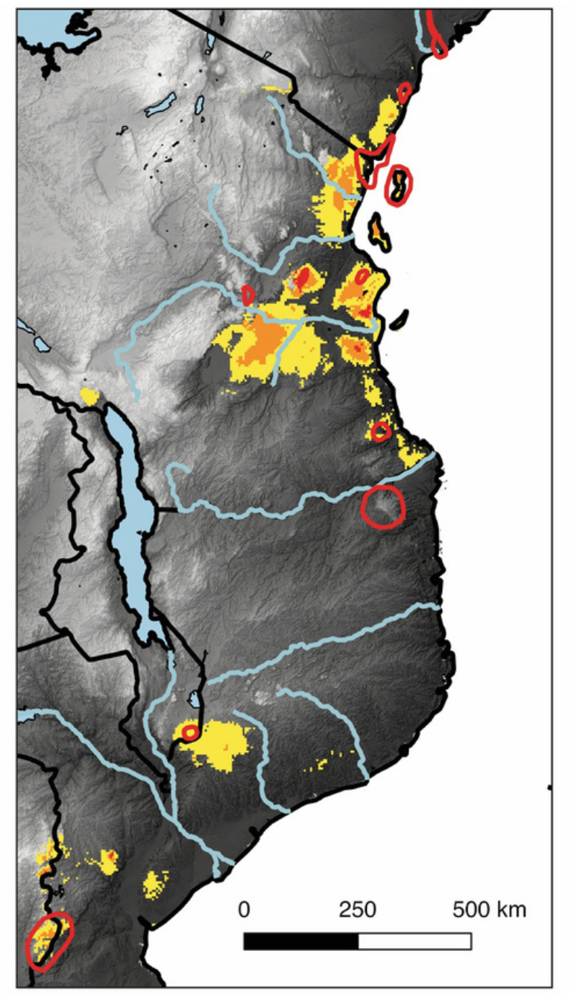
Summary – all results so far
Now we have a very good handle on population structure, admixture between pops, evolutionary relationships between pops and potential barriers to gene flow across the landscape (where FST is higher than expected due to geography)
We may also have an idea of the historical ranges of these populations using SDMs projected into the past (not essential)
So we can use all of this information to build sensible demographic models to be tested in ∂a∂i…

Slide 61
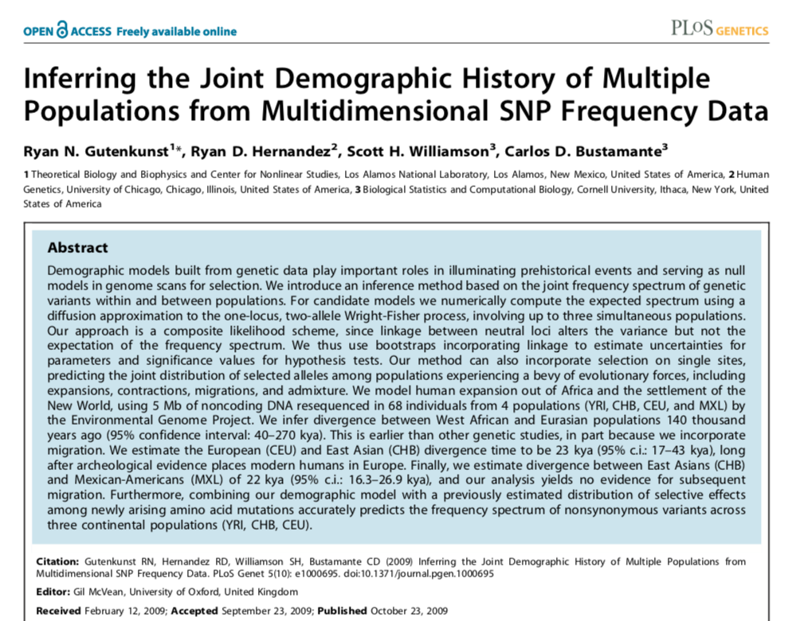
Demographic model selection - ∂a∂i
∂a∂i is an extremely powerful and flexible framework for demographic inference (Gutenkunst et al. 2009)

Slide 62
Demographic model selection - ∂a∂i
Uses the Joint Site Frequency Spectrum (JSFS) between populations (1D, 2D or 3D)
JSFS are multi-pop SFS; a summary of SNP allele frequency distributions between populations (Wright-Fisher models)
Shape of the JSFS is sensitive to demography, such as population size changes, migration, and substructure
Comparing observed empirical data to the expected JSFS under a given demographic model, we can assess the goodness of fit of that the model to the data, and use likelihood theory to estimate the best fit parameters
Keep in mind that no model is ever perfect!

Slide 63
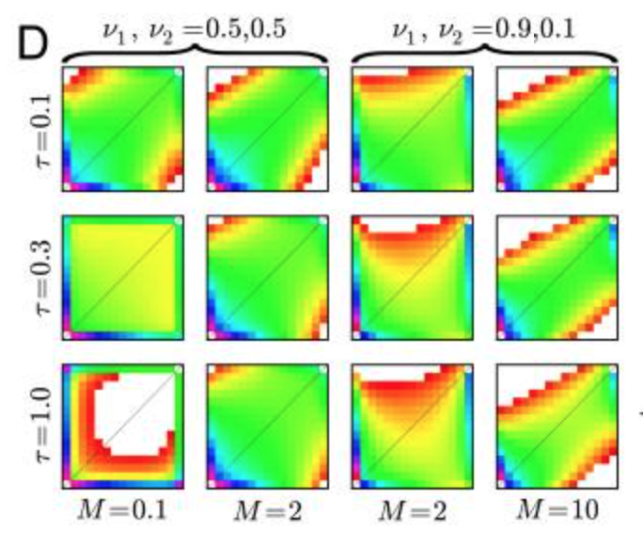
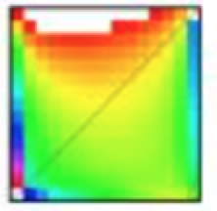
Demographic model selection - ∂a∂i
We build and test models to be compared against empirical data
Each model needs to be optimized to best fit the data, then likelihoods and AIC calculated
Best likelihood and smallest delta AIC = best explanatory model
?

Slide 64
Demographic model selection - ∂a∂i
What’s happening under the hood in ∂a∂i?
Build SNP matrix from the SNP data
Calculate observed JSFS (3, 1, 0, 1) [derived from 111, 2, x, 4]
Calculate expected JSFS under different hypothetical models (time steps, migration, pop size changes)
Assess goodness of fit between observed and expected data in a composite likelihood framework
 | SNP 1 | SNP 2 | SNP 3 | SNP 4 | SNP 5
Sample 1 |  |  | 1 | 1
Sample 2 |  | 1 |  | 1
Sample 3 | 1 |  |  | 1 | 1
Sample 4 |  | 1 |  | 1
Total | 1 | 2 | 1 | 4 | 1

Slide 65
Demographic model selection - ∂a∂i
Running and interpreting ∂a∂i can be an total nightmare. Dan Portik (University of Arizona) wrote this stunning pipeline which can be used to automate model selection: https://github.com/dportik/dadi_pipeline
You still need to do a lot of thinking and piecing together previous evidence (e.g. pop structure, evolutionary relationships etc., migration) to build suitable models to fit your study system (i.e. hypotheses testing)
Another important consideration is that you will need unlinked SNPs to perform AIC-based demographic model selection (this is fine for us as I used the write_single_SNP option in Stacks for these data!) – but keep this in mind before you analyse your own data

Slide 66
Demographic model selection - ∂a∂i
The version of the pipeline we are using is the version before the current version which was uploaded about 2 weeks ago (you need to build Tkinter with your python version to run the new version, which I have not done yet)
The main difference in the new one is that run optimizations are combined into a single .py script (dadi_Run_3D_Set.py) where previously they were separate for each model
In public/barratt/work/Lflavomaculatus/Inputs/dadi there are:
dadi_3pops_north_south_taratibu_snps.txt – the SNP data input
15 models to test (dadi_Run_Optimizations_MODEL_NAME.py)
Optimize_Functions.py (and pyc) where the functions are stored

Slide 67
Demographic model selection - ∂a∂i
FYI dadi_3pops_north_south_taratibu_snps.txt was created using Dan’s other Stacks haplotype converter: https://github.com/dportik/Stacks_pipeline/tree/master/4_haplotype_to_dadi_SNPsFile
This takes the output haplotypes.tsv file from Stacks and some population information (e.g. those population clusters we found in our DAPC and pop structure analyses)

Slide 68
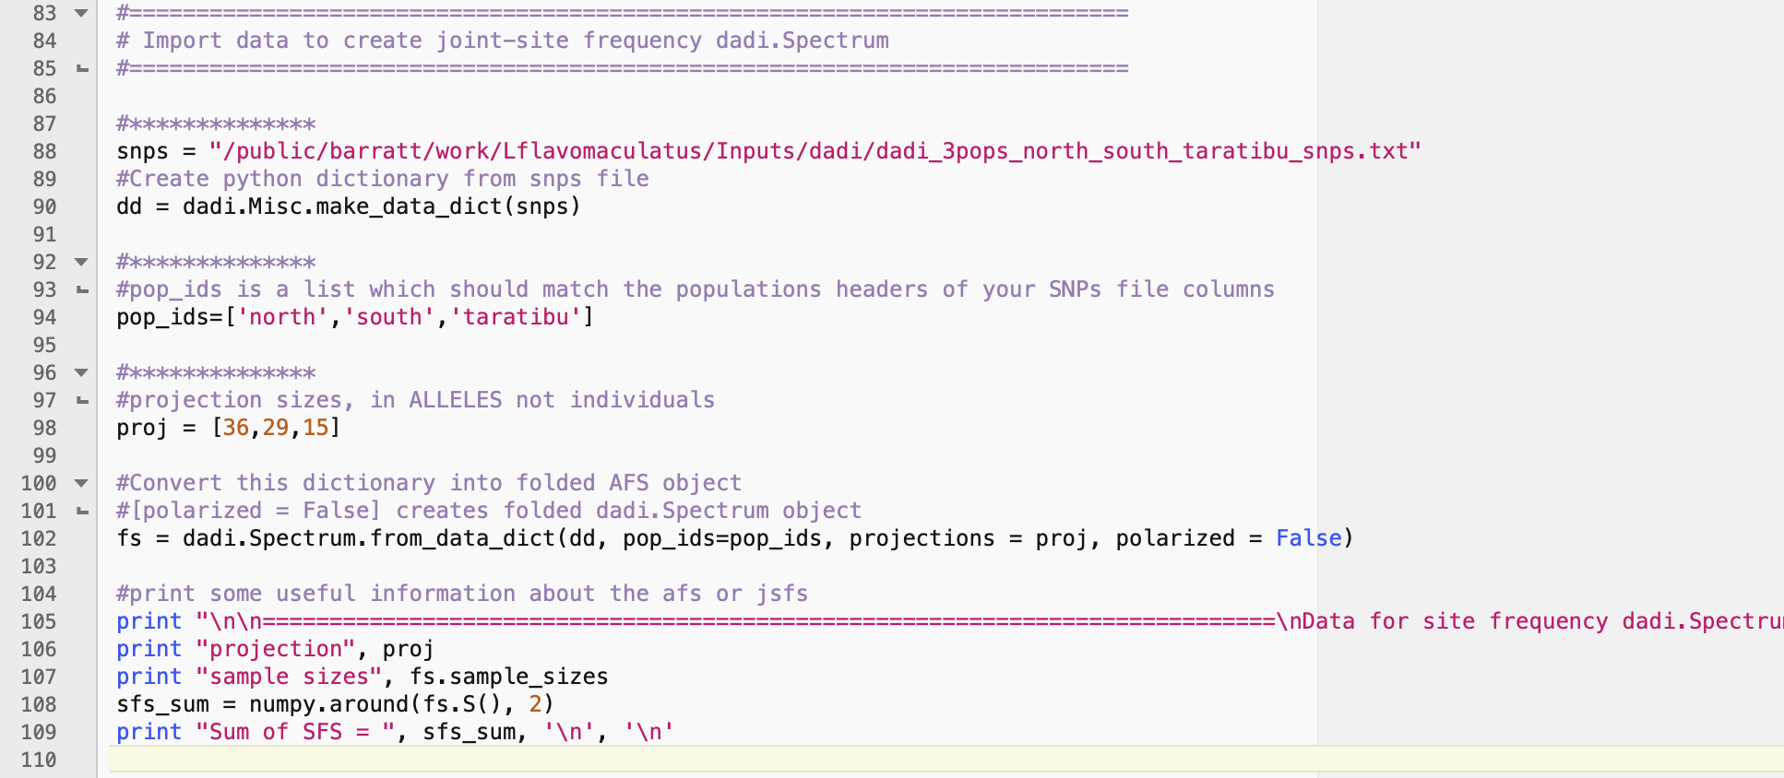
Demographic model selection - ∂a∂i
OK, let’s take a look at one of the model python scripts
There are lots of comments and then the main information telling dadi how to build the SFS from the file (giving population names and allele projection sizes)

Slide 69
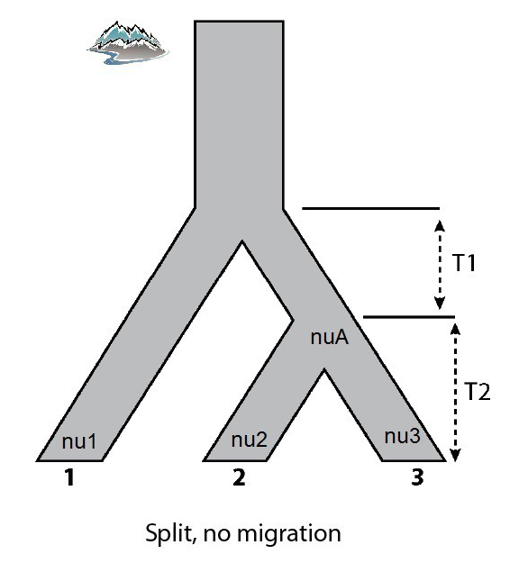
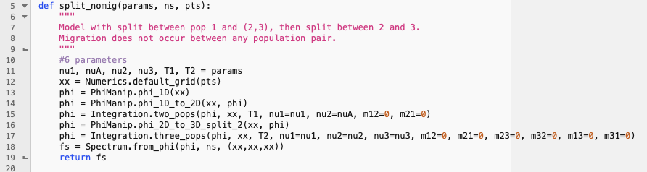
Demographic model selection - ∂a∂i
Scroll down a bit further and you will see the models themselves (all models are defined in every script as it does no harm to define them all). Here is the code for the first one, along with a visual representation
Note the important details – 6 params
The location of the params in relation to where the divergences/pop size changes/ time steps are is important!

Slide 70
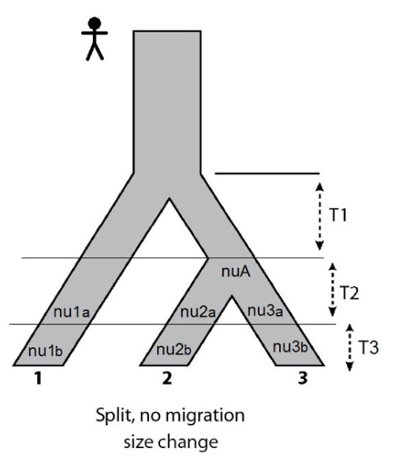
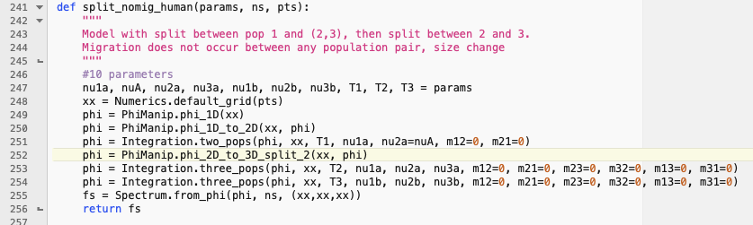
Demographic model selection - ∂a∂i
Another model is very similar at first glance but the inclusion of an extra time step and parameters indicating recent size changes means that the biological interpretation of this model should be quite different

Slide 71
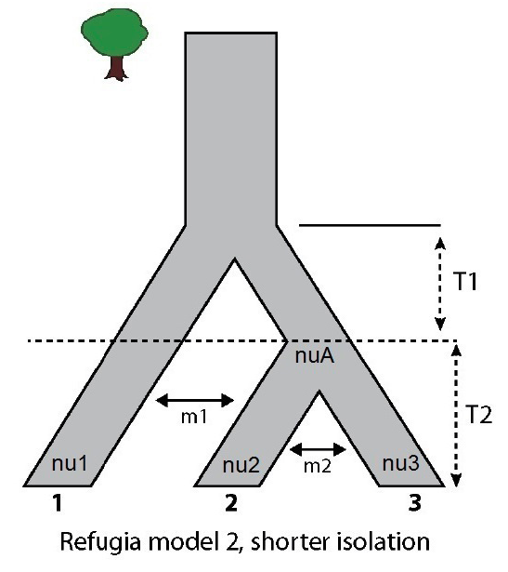

Demographic model selection - ∂a∂i
Again, this model is very similar to the first, but added migration after an initial period of isolation changes the interpretation of what is happening. We won’t go through all the models but spend a few mins looking at the model code and how they differ from one another, and think about how to apply this to your own study system!

Slide 72

Demographic model selection - ∂a∂i
A v. important part of each script is telling the optimization routine some information… This needs to be kept consistent across models if you are later comparing them (except the model specific parameters such as p_labels, upper/lower)
pts – extrapolation dimensions for grid size
p_labels – parameter labels
Upper/lower – bounds the parameters are allowed to range from
reps – how many replicates across each round of optimization for each model ?(I reduced this here for runtime – I would recommend at least 10, 20, 25)
maxiters - maximum iterations of each replicate to do (again I reduced this, I would set it to 3,5,10 for example)
folds – controls peturbation of input parameters across rounds

Slide 73

Demographic model selection - ∂a∂i
To run all of these models in parallel I provided a bash script – run_dadi_jobs.sh. This needs to be submitted with bash (so bash run_dadi.jobs.sh)
This is submitting a job for each model (all .sh scripts in submit_scripts/dadi which are in turn calling the python scripts for each model in Inputs/dadi)
Some of these take >1 day, even with reduced replicates – your own data will take several weeks for complex 3D models!

Slide 74

Demographic model selection - ∂a∂i
For each model there will be an _optimized.txt file output when it is done
This will contain all of the replicates across all rounds of optimization, with log likelihoods, AIC scores, some other statistics and the optimized estimated parameters per replicate

Slide 75
Demographic model selection - ∂a∂i
The log likelihoods should stabilise across optimization rounds – what the scripts automatically do is supply the parameters from the best scoring replicate of the first round into the second round and then into subsequent rounds so it is always starting the likelihood search from an ‘optimized’ position
You can check the log likelihoods across replicates to see if the log likelihoods have converged for each model. They should become more stable as you do more rounds of optimization

Slide 76

Demographic model selection - ∂a∂i
Ideally something like this (split_no_mig)
First 5 are round 1, second 7 are round 2, final 10 are round 3

Slide 77

Demographic model selection - ∂a∂i
This one (anc_mig_3) not quite as trustworthy….
If you run all models out long enough they should all converge on stable(ish) log-likelihoods eventually

Slide 78

Demographic model selection - ∂a∂i
Finally, to see which models you have tested are the best fit to the data take the best AIC model for each tested model
That alone is informative between models, but you should verify this result using Akaike weights
I did this next step in excel, just because it’s easy and fast… paste your best scoring replicate from each model into excel, so here you have 14 models (one of my models failed…)

Slide 79
Demographic model selection - ∂a∂i
Insert 3 empty columns somewhere (doesn’t particularly matter where) and call these something informative
Calculate the delta AIC for each model (the AIC minus the best scoring AIC across all models)
Calculate the relative likelihood for each model =EXP(-0.5*delta_AIC)
Calculate the Akaike weight for each model (= relative likelihood/ sum of all relative likelihoods)

Slide 80

Demographic model selection - ∂a∂i
Your excel sheet should look like below, if so then you’ve successfully ranked your models using Aikake weights based on Akaike Information Criterion (Burnham and Anderson, 2002)
Now you can definitively say which of the hypotheses is most supported by your empirical data!
But make sure you run the models long enough (this was too short here, even though some were running for a day)

Slide 81

Demographic model selection - ∂a∂i
When you have your best model you might want to plot the model SFS against the empirical data. You can do this with the plot_dadi_best_model.sh script
This is calling Make_Plots.py and some functions in Plotting_Functions.py in the Inputs/dadi folder
Plotting_Functions doesn’t ever need editing but you need to pass the correct information to Make_Plots.py…

Slide 82

Demographic model selection - ∂a∂i
These lines are where you specify which model(s) results to plot, including the optimized parameters and outputfile

Slide 83

Demographic model selection - ∂a∂i
Your output will look something like below. Top row are the data itself (3 plots as it is 3 pop comparisons), second row is the model
Third row and fourth are residuals – model predicts too many or too few alleles in a given cell (these should be close to 0 mostly)
You can see here that this is not yet a great fit (model was not run long enough to be sufficiently optimised… this is essentially the best of a bad bunch!). Remember that the model is only an approximation of reality, the most likely but not yet the truth!

Slide 84
Recap
You’ve learned how to (begin to) make sense of your short-read data:
2 separate population structure analyses (Admixture and DAPC)
2 methods to look at evolutionary relationships (RAxML and SNAPP)
1 method for investigating barriers and connectivity (EEMS)
1 method for investigating likely demographic history (∂a∂i)
These are just some of the tools, there are many many more which address similar questions….

Slide 85
Recap
These are just some of the tools which I use, there are many many more which can address similar questions…
Stacks, iPyrad, dDocent, ANGSD
Admixture, DAPC, Structure, SNMF, NGSAdmix, fastStructure, fineStructure, fineRADstructure
RAxML, SNAPP (BEAST), SVDquartets, Astral2, SNPhylo, SnpTree
EEMS, MAPS, TreeMix
∂a∂i, FastSimcoal, Moments

Slide 86





Now go and do something that makes you happy!

